Slide 1
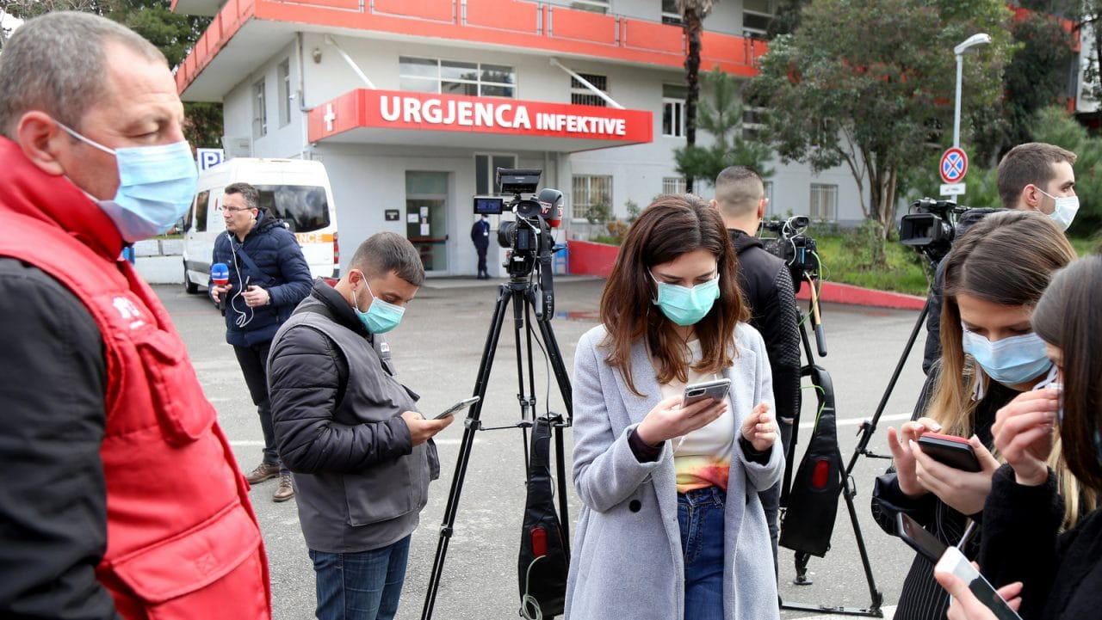
Do’s & Don’ts for Journalists while covering Corona Virus
: Snehasis Sur

Slide 2
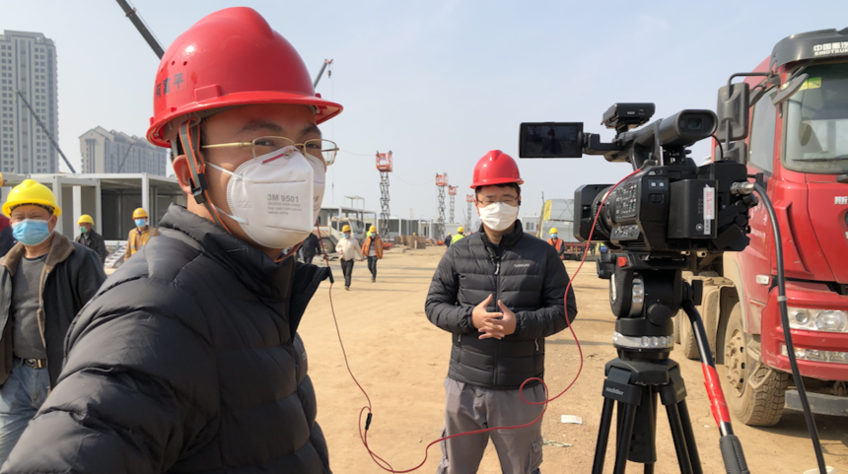
Your goal should be
to cover News,
not to be News
and in this case
you shouldn’t spread the dreaded Virus

Slide 3
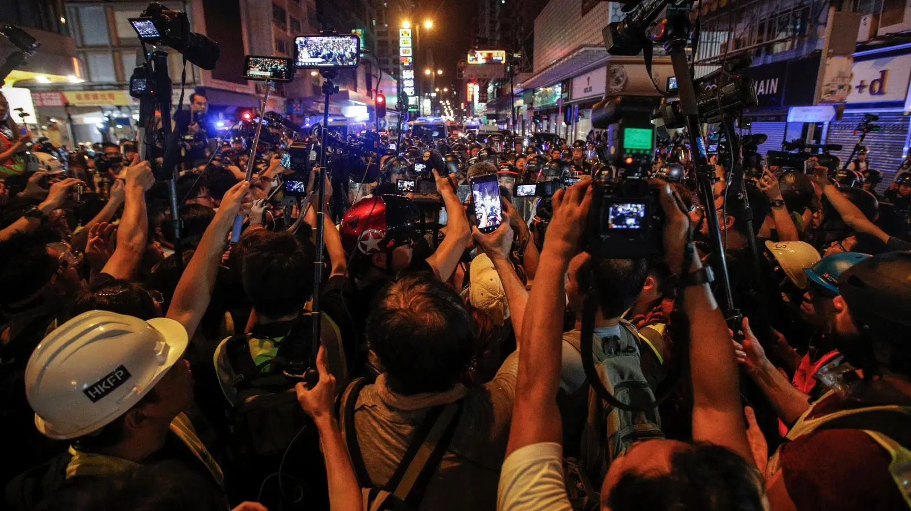
Our Journalists have covered
Bundhs, Riots, Curfew, Terrorism; Public Unrest, Fire, House Collapse,
Natural Calamities like
Earthquake, even Tsunami;
Diseases like
Swine Flue, Dengue, Plague
and many other Crisis Situations,
but had no experience of what is happening now with the threat of spread of dreaded Corona Virus.

Slide 4
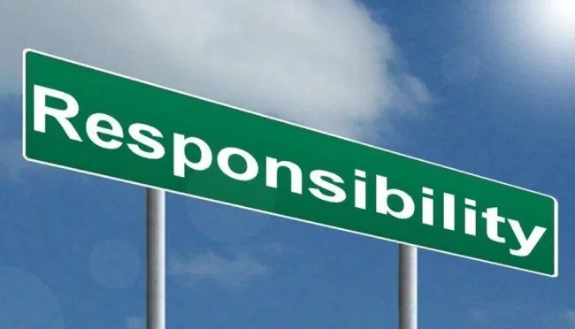
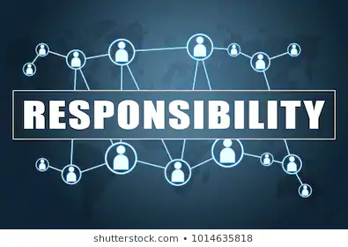
Responsible - Journalist, - Individual, - Citizen
Responsibility to one’s own self
Responsibility to his/her family and
Responsibility to Society at large

Slide 5
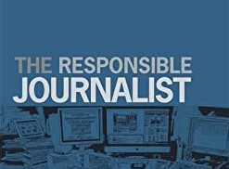
Responsible Journalism includes
A Journalist cannot be instrumental in spreading the dreaded disease
Journalists are exempted from Lock Down and Media is being considered as Essential. That means journos cannot move anywhere and everywhere like a normal situation
Media also is required to scale down its Human Resources and their physical movements

Slide 6
While Entire Country is under Lock Down, we need to understand the importance of Social Distancing
The Journalists are to go to the Spot for collecting accurate news, for showing the ground reality
However, good that some have started Remote Recording, like
Video Conference; Video Output, Facebook Live
Nice that Channels have started recording through Zoom; Skype, etc.
May compromise with quality at this trying time
However, we should not be crowding at a particular spot
Can’t we share the visual
Can’t we depend on crowd sourcing

Slide 7
Covering Vulnerable Areas – Hospitals, etc.
Reporters were seen collecting Sound Bites from those who were standing in a queue for getting their tests done at an ID hospital
Can’t we manage with an Establishment shot and
voice over with it, or
Even a Piece to Camera in front of the hospital
Taking Interview of the Suspected Patients from the queue is a big safety threat, not only for the Reporter but for many others in the chain

Slide 8
Personal Hygiene
Hand Wash,
extensively for at least 20 seconds, as demonstrated, at regular intervals
Use of hand sanitizers with min 60% Alcohol
Don’t remain in empty stomach at work

Slide 9
ON Return
Wash used clothes
Keep off your shoes outside
Keep Purse, Cell Ph, Watch, Note Book, Comb, Car Keys, etc. separately at entry pt.
Take bath on return
Don’t go close to children and aged
May sleep in a separate room

Slide 10
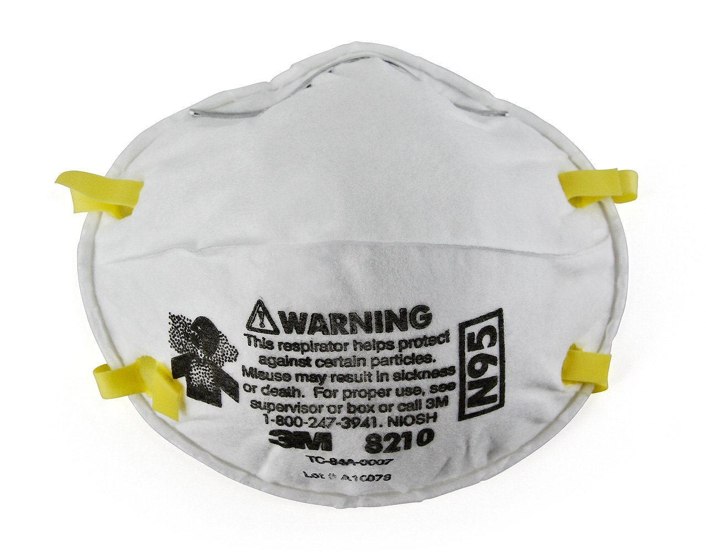
Mask – Follow Directive
Whether mask is to be used at least while going out
Whether Mask is required for the Journalists going on assignment
N-95 Mask, which protects Virus
Price of N-95 Mask,
Longevity of Mask for single use
Whether normal Mask is of any help

Slide 11
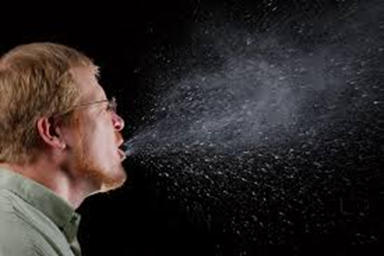
Personal Health
Journalists often don’t care of his/her own wellness for call of duty
Please take care of yourself at this crisis / critical moment
If you have
Cough; Cold; Throat pain; Fever;
Or other symptoms like Corona affected
Please contact Doctor and your Authority
May have to go for Isolation
May not be for you but for others

Slide 12
Your Personal Practice
Keep note of whom you came into contact in last 14 days
Don’t go to places in office where you may not be required
Pregnant and aged should work from home
Personal health Norms will depend on the overall situation of the pandemic in your area of work and as per Directions of the Govt. & Competent Authorities

Slide 13
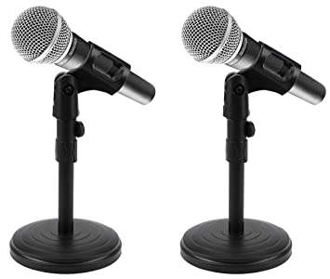
For TV Journalists- Microphone is a medium of contamination
Keep More Distance between Interviewer & Interviewee
Give Tabletop Microphone to Interviewee to increase your
Personal Space

Slide 14
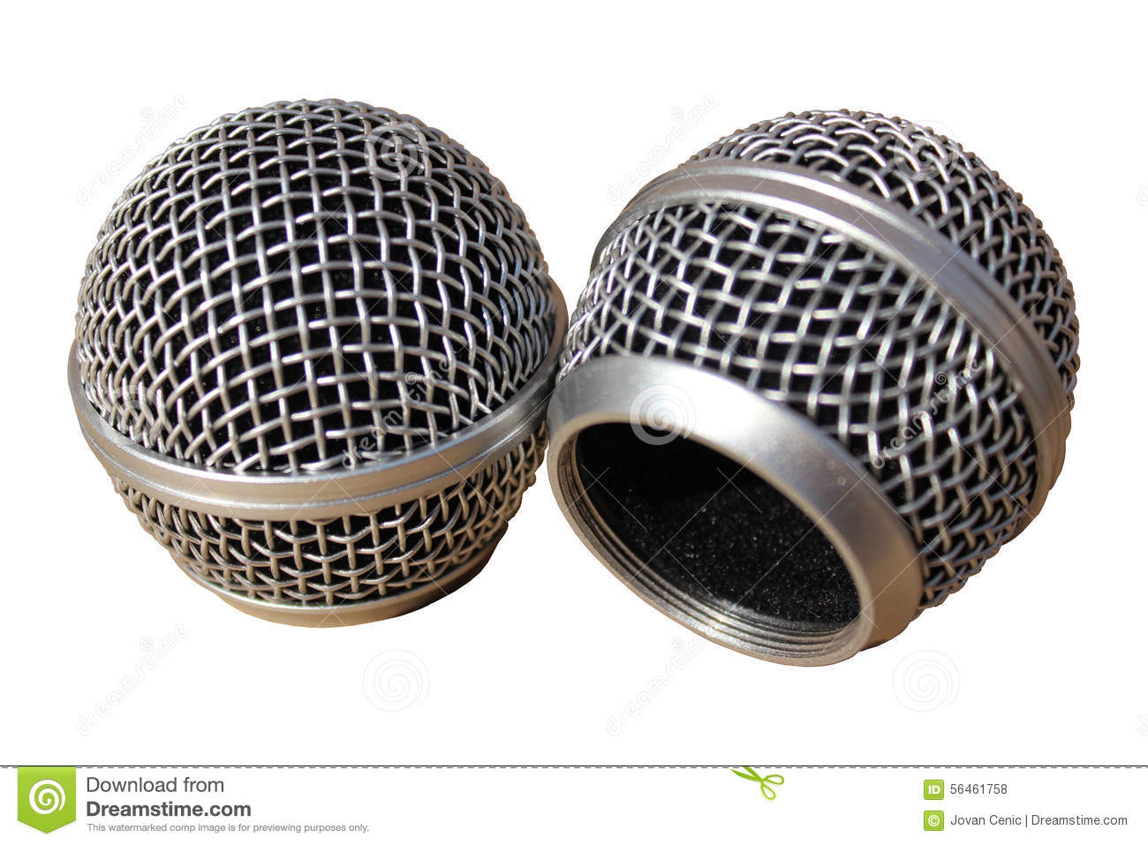
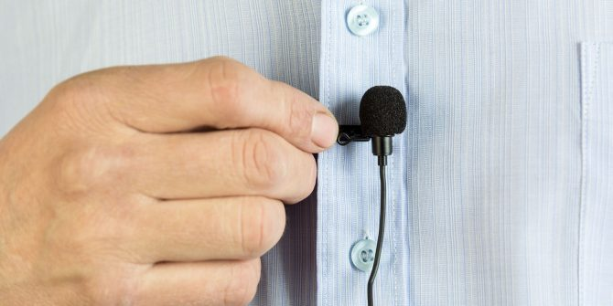
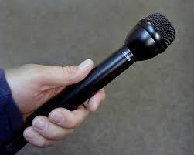
Clean Head Basket and Wind Shield of the Microphone intensively and all Equipment
Head basket of Microphone
Detach it, Clean it properly
Clean/change inside sponge
Also clean
Body of the Microphone
by using cleaner or Alcohol based cleaning solution
Avoid Lavalier (Lapel) Microphone to avoid
Body contact

Slide 15
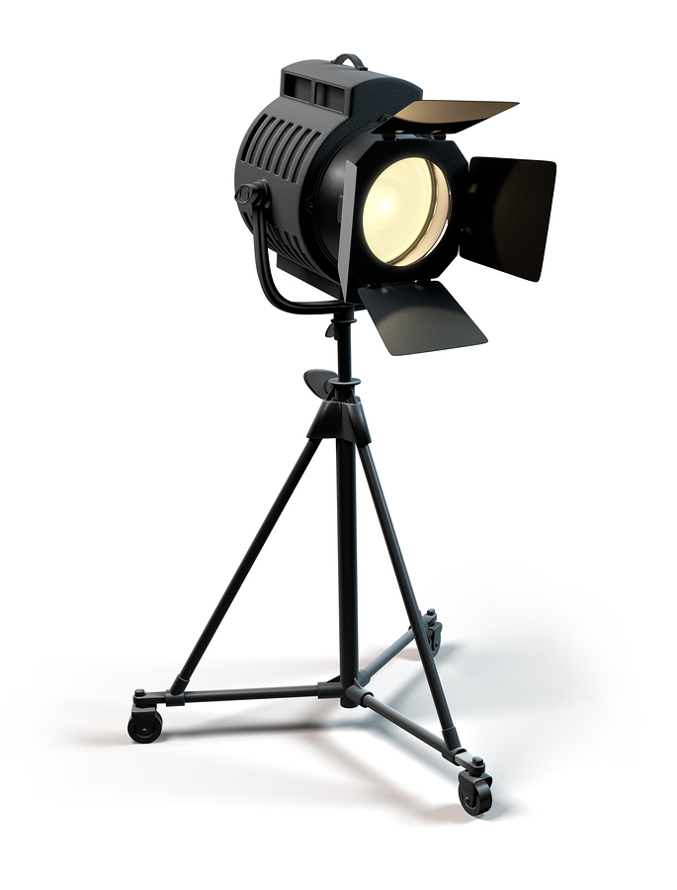
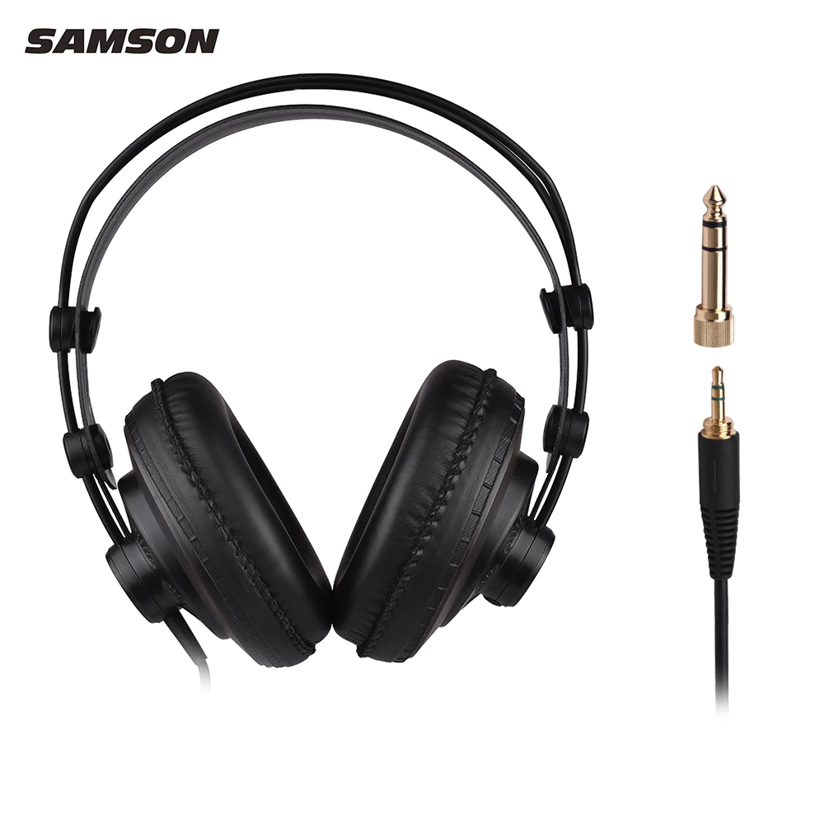
Clean Camera & Other Accessories after returning from Coverage
Clean by using cleaner or Alcohol based cleaning solution

Slide 17
Cleaning your Mobile Phone – especially now
Cell Phone is an integral part of everybody’s life, more so to the Working Journalists. Keep coronavirus off your phone.

Slide 18
How to effectively disinfect & clean Cell Ph
You handle it constantly and often press to the side of your face, so any bacteria, virus or other germ comes to your phone which could easily be transferred to you.
Disinfectant wipes are safe to use on phone screens with 70% isopropyl alcohol
Spray a nonabrasive or alcohol-based (70% isopropyl) disinfectant directly on a soft lint-free cloth and wipe down your device while it is powered down and unplugged.
Using paper towels are far too abrasive
The safest and most effective way to clean your screen is with a microfiber cloth.
The best solution for removing sand and lint is Scotch tape
For the smaller speaker holes, use a toothpick or try to vacuum the debris

Slide 19
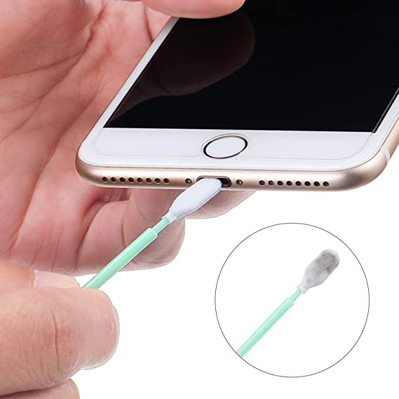
8 Things you should never use to clean Cell Ph
Window cleaner;
Kitchen cleaners;
Paper towels;
Rubbing alcohol;
Makeup remover;
Compressed air;
Dish soap and hand soap;
Vinegar

Slide 20
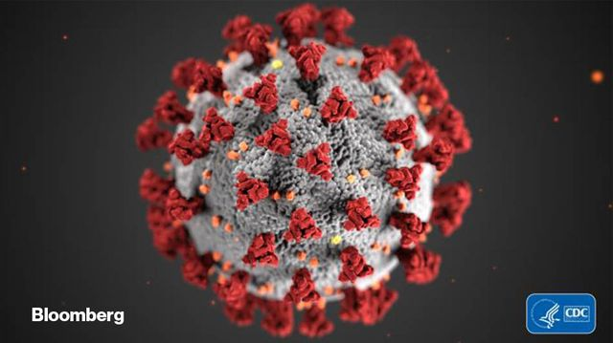
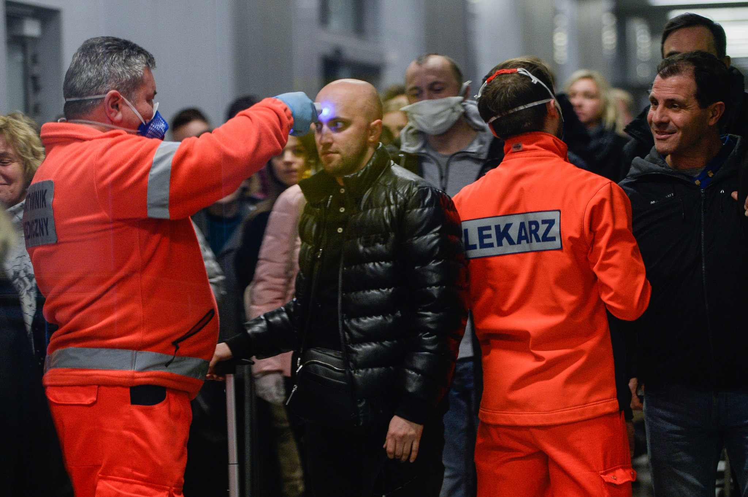
Stay Well, Keep Well, even covering Corona

Slide 21
Acknowledgements: Committee for Protection of Journalists (CPJ) Newslaundry.com Transom.org cent.com
Thank You

