Slide 1
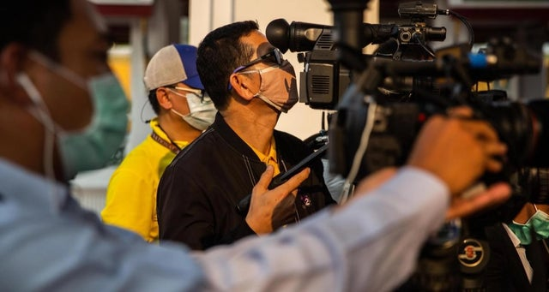
Staying safe: a guide for media covering COVID-19
“First do no harm”

Slide 2
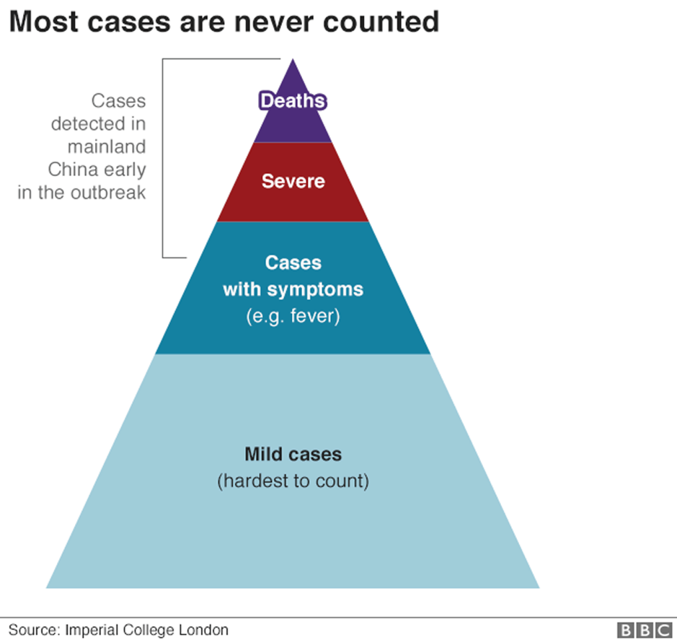
COVID-19: People are vectors

Slide 3
COVID-19 and people as vectors
Journalists are people
All journalists’ interviewees are people

Slide 4
“First do no harm”
A basic principle in medicine, and journalism too.
In the time of COVID-19, consider:
First do no harm – to yourself.
Also, do no harm to others.
This presents dilemmas for journalists

Slide 5
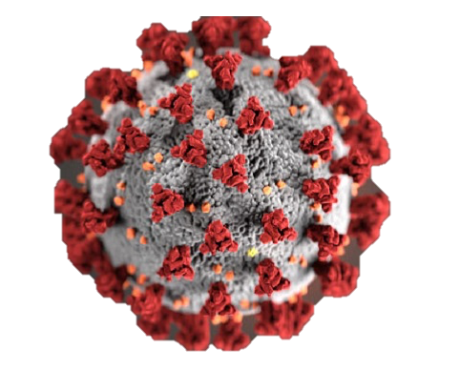
COVID-19 safety considerations
Essential services
Check country guidance
Check if colleagues & friends know the guidance and if media houses have organized around standard application?

Slide 6
COVID-19 safety considerations
2. Demand for Personal Protective Equipment
Evolving guidance about best practice
Check if colleagues & friends are clear about best practice

Slide 7
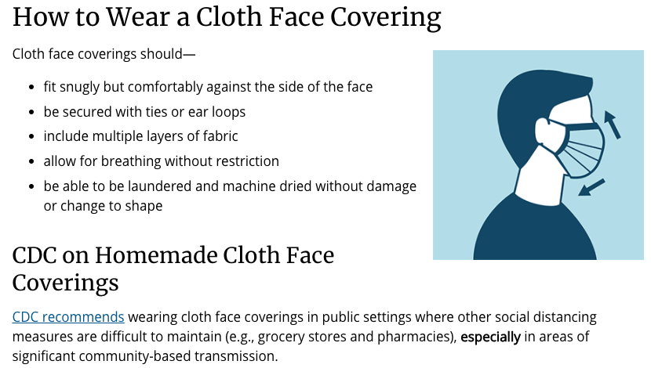
COVID-19 safety considerations
Source: CDC

Slide 8
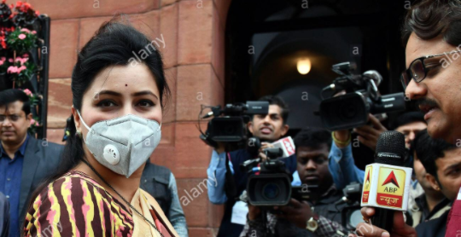
COVID-19 safety considerations
3. Revolutionary ways to gather news and information
No physical contact with interviewees
#WorkFromHome
(Photo: Partha Sarkar/Xinhua 5 March 2020)

Slide 9
COVID-19 safety considerations
3. Revolutionary ways to gather news and information
(Photo: Lauren DeCicca/Getty)

Slide 10
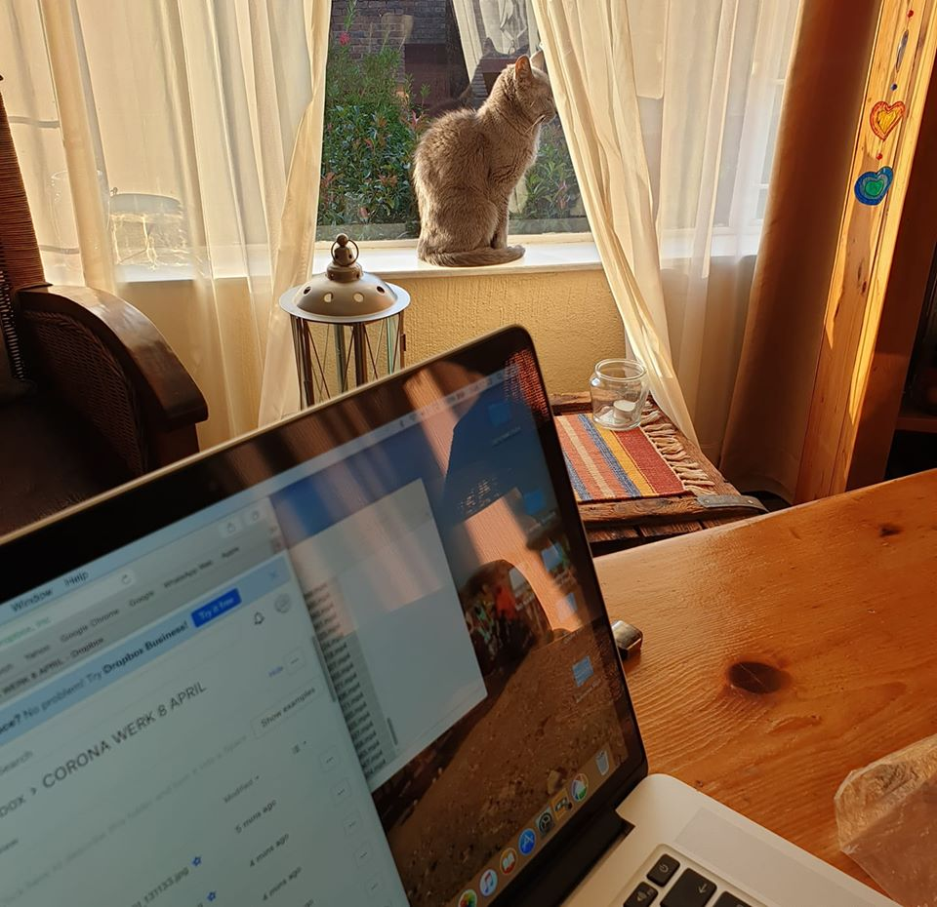
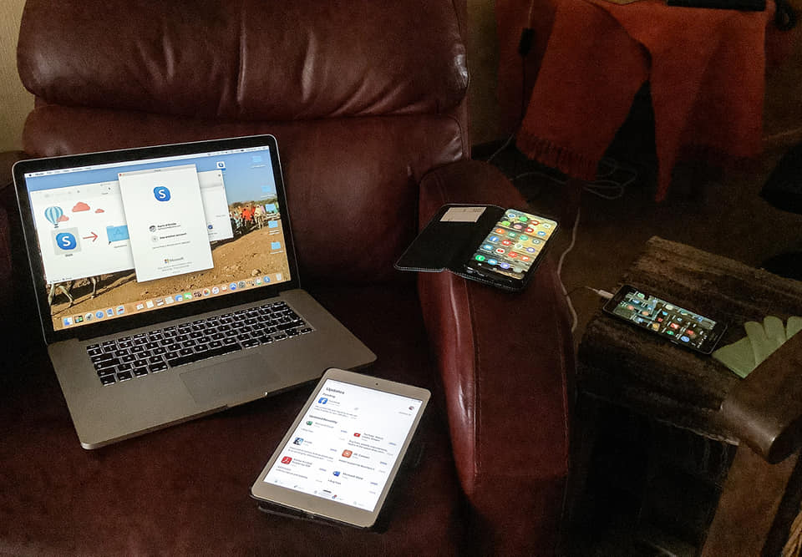
COVID-19 safety considerations
3. Revolutionary ways to gather news and information

Slide 11
COVID-19 safety considerations
3. Revolutionary ways to gather news and information
TV: Content is king. Pixels and picture quality – less important.
Broadcast crowd-sourced cell phone videos to tell stories about isolation, new
business practices, empty streets, etc.
Radio: Maximise phone-in formats and voice recordings of interviewees
Online production: Practices are already familiar. Continue to tell the unfolding story in credible and impactful ways, to keep your audience.
For all of the above, use credible and own known contacts.
Invest in data and stable internet: Ask for editor support
Use transport savings towards data bundles
Look for opportunities for stipends and grants

Slide 12
COVID-19 safety considerations
3. Revolutionary ways to gather news and information
Newsgathering by distance: Mobile Journalism practices, Skype, Zoom, WhatsApp Audio and Video, Images and audio recordings sent via WhatsApp, hosted via Facebook Watch Party, etc
Let’s Crowd-source innovative practices and share

Slide 13
COVID-19 safety considerations
3. Revolutionary ways to gather news and information
Media partnerships for source-sharing
Revised editorial and ethical guidelines

Slide 14
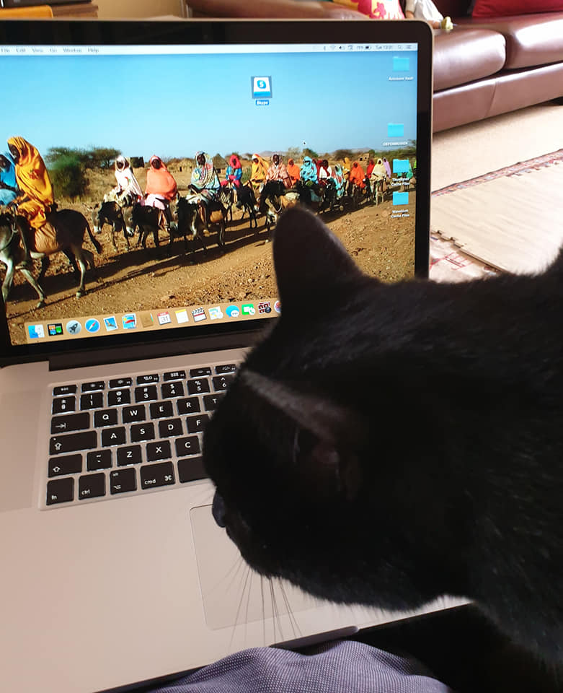
COVID-19 safety considerations
More revolutionary ways to gather news and information
Telling the story by distance draws on the journalist’s skill to make connections, make meaning.

Slide 15
COVID-19 safety considerations
4. Stay digitally safe
Playing into fears and biases, individuals and organizations are putting out hooks to eventually steal our ID and data.
New Apps are new opportunities for abuse:
Hackers recently exploited Zoom’s newfound popularity,
prompting updated safety features.

Slide 16
COVID-19 safety considerations

Slide 17
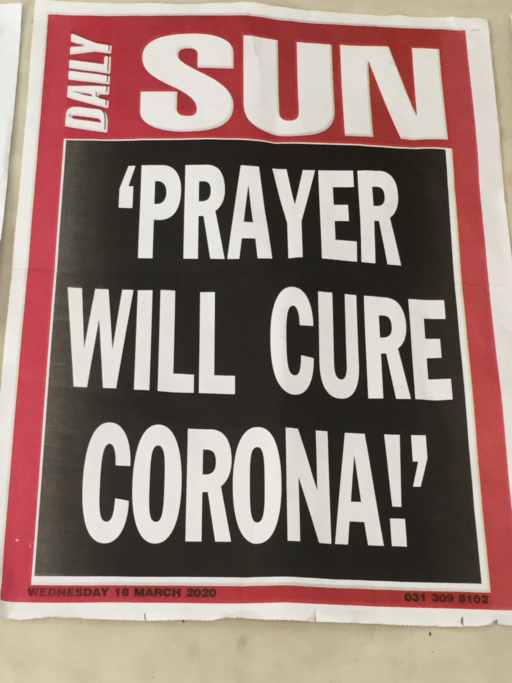
COVID-19 safety considerations

Slide 18
COVID-19 safety considerations
4. Stay level-headed … and protect yourself and colleagues, friends & partners against misinformation
#NoSourceNoForward
Consult resources on debunking myths
FactCheck and RealityCheck

Slide 19
COVID-19 safety considerations
5. Mental health: a duty to self, family, friends and colleagues.
Consult best global guidance, e.g. WHO and MHN
Before there is a crisis, enquire about local support and make colleagues & friends aware
Take breaks from COVID-19
Connect with loved ones

Slide 20
Stay safe, stay home

Slide 21
Challenges and solutions?
Social distancing in congested homes and suburbs
Data costs, internet reliability
Deepening the digital divide
Uncooperative editors
Maintaining credibility
Newsrooms and platforms’ survival and sustainability?
State control of communications
Tech glitches
Overwhelm
And and and …..

