Slide 1
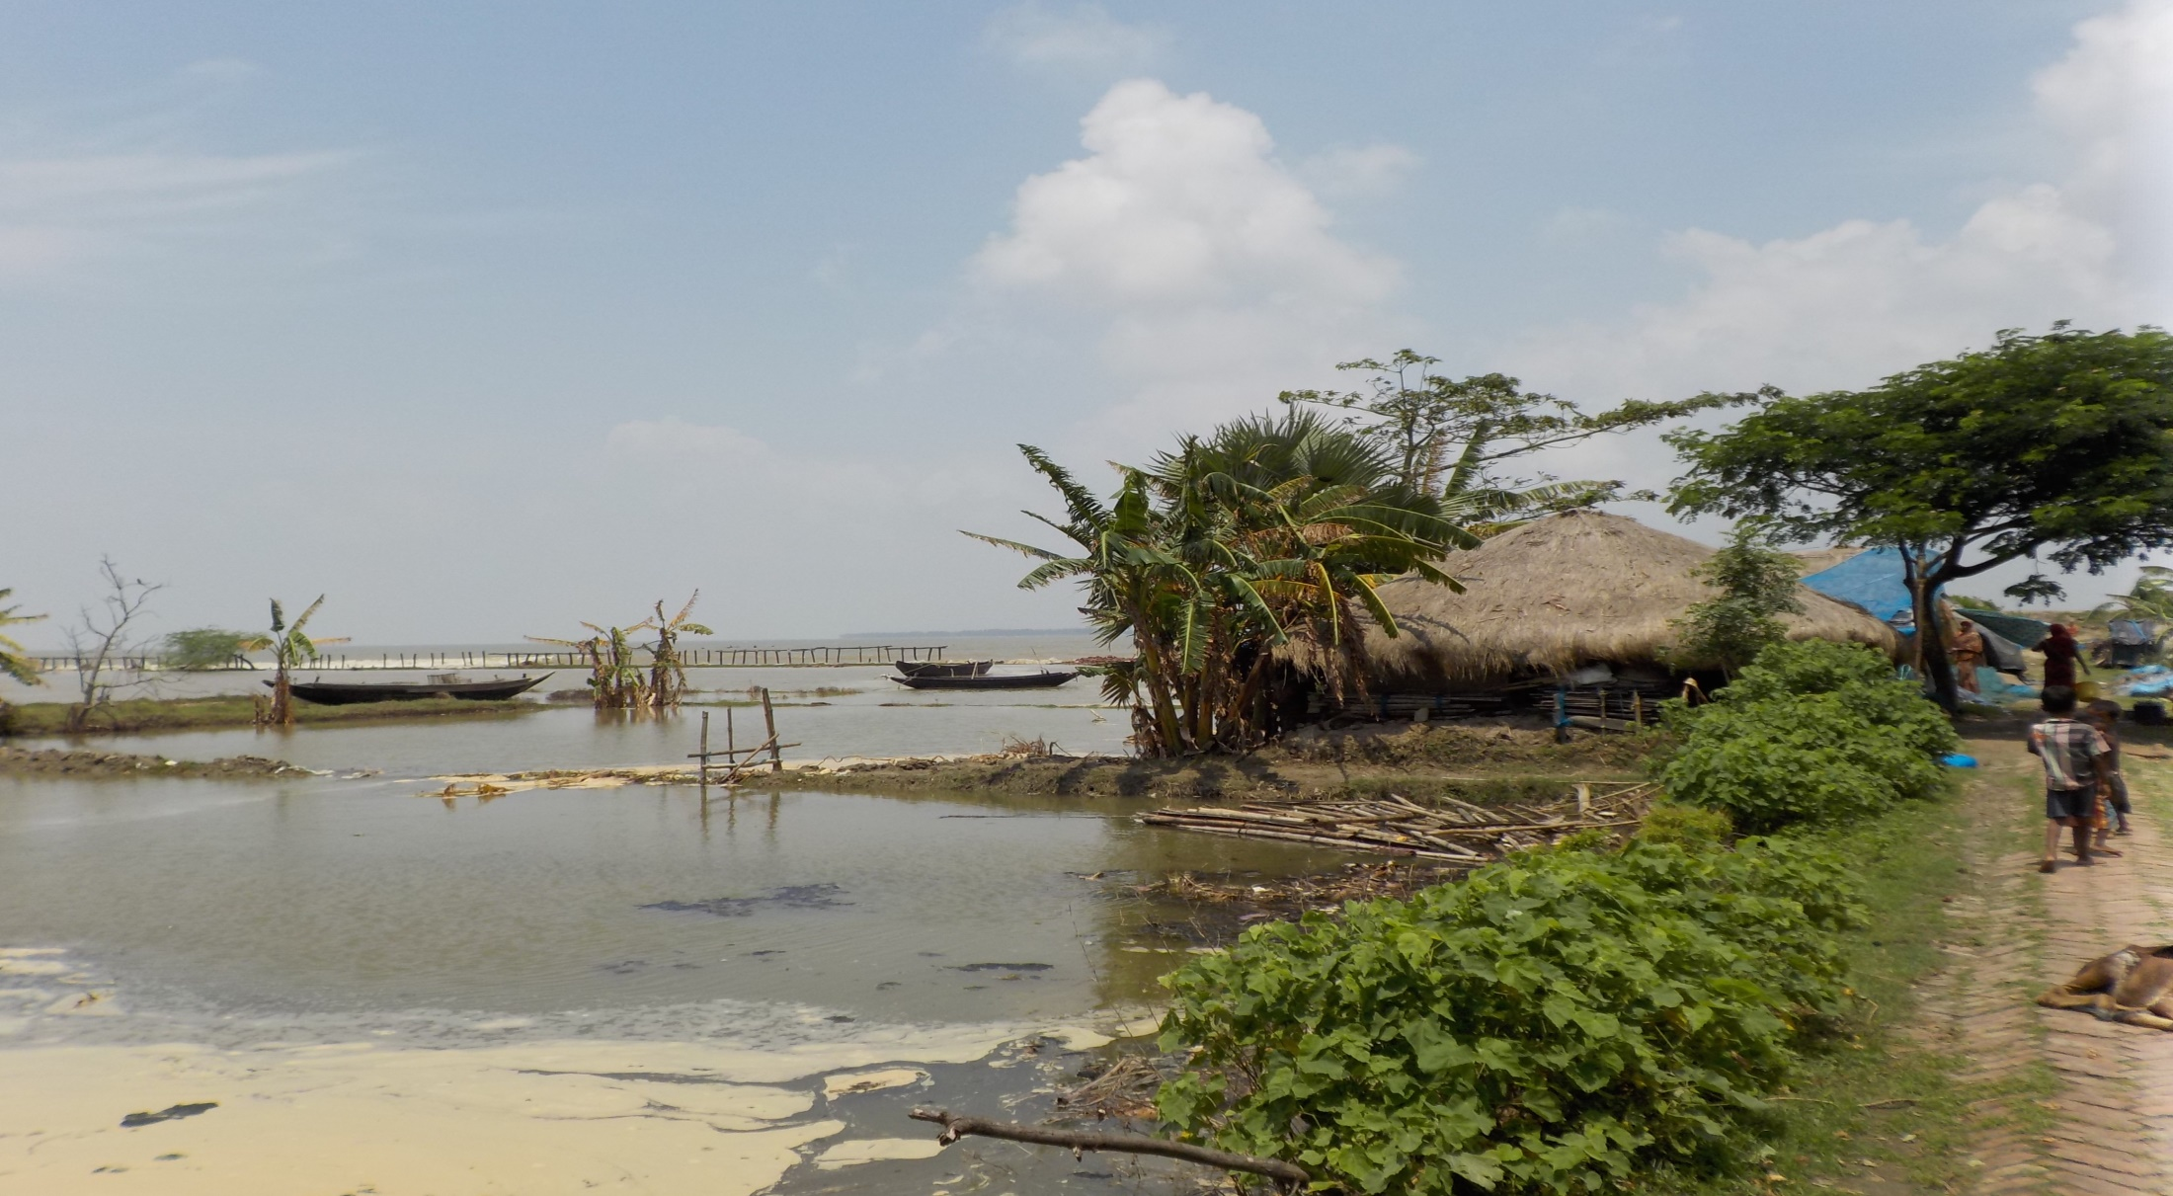
Community health in a salty environment: Case of Bengal Delta
Dr. Upasona Ghosh
Indian Institute of Public Health

Slide 2
Communities amidst uncertain climate
From self-sufficient economy to a market-dependent one
Transition from farmers/fishers to wage laborers
Transition from food producers to consumers
A continuously mobile population
Inter-island and island to mainland migration
Rural to urban
Inter-states
Inter-country (Trans-boundary Sundarbans)
Transition from nature worship to mainstream religion
Less dependency on nature, dwindling faith on Bon-bibi
Changing identity from nature-harnessing community to climate refuges
Reverse migration due to COVID-19 situation
Trapped between rural and urban life- dynamics
Migrating in cities without alternative life skills
Difficult life in workplace and slums
Lack the knowledge of entitlements

Slide 3
Pathways of Impact on health and nutrition
climatic change (manifestations)
Sensitivity
Geographical position (islands, river locked, erosion prone)
Social position (gender, caste, religion)
Livelihood options
Gradual events like erosion, erratic rainfall, dry spell
Sudden events like floods and cyclones
Land loss (agriculture, home stead)
Non-communicable diseases
Declining fish catch
Displacement
Changing food system
Under nutrition
Community’s health and nutrition
Increase water borne diseases
Crop loss
Shelter demolished
Health infrastructure damaged
Seasonal male outmigration
Individual and community resources
Social security
Healthcare system

Slide 4
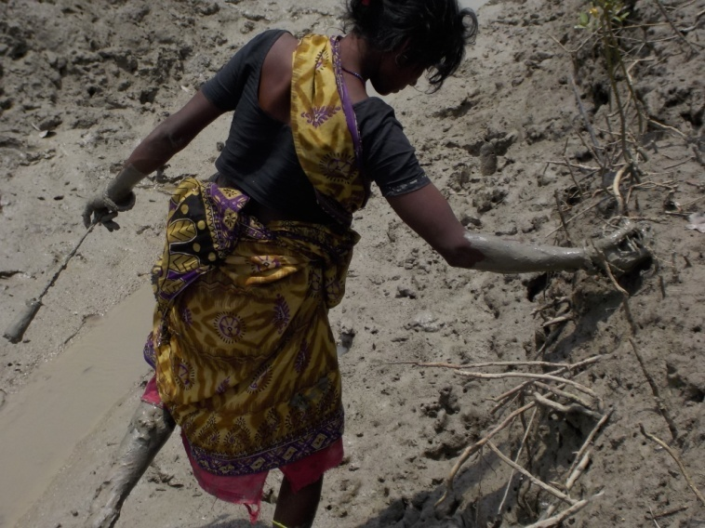
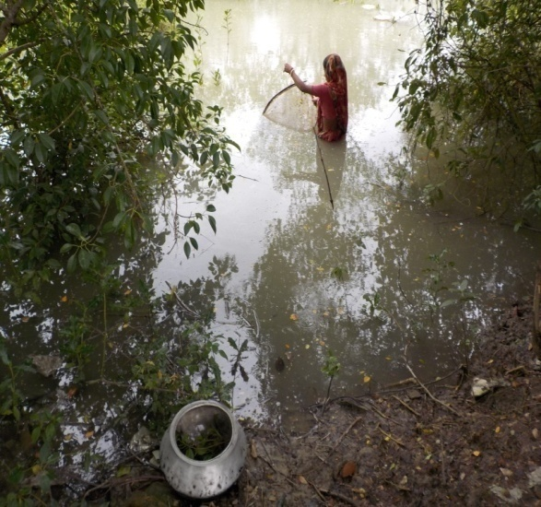
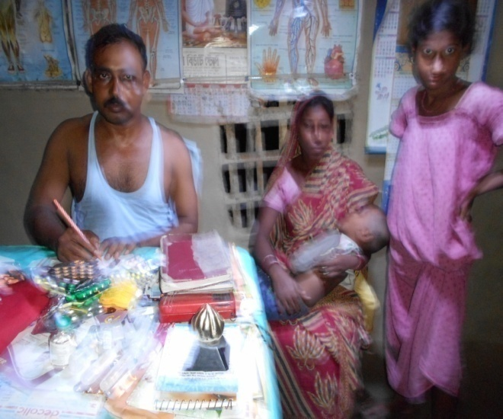
Health Scenarios: Impacting Social Determinants
Livelihoods effect on health and health system
‘Meen dhara’ (prawn seed collection) entails standing in waist high saline water for long periods causing uterus cancer. There are lot of example in our village
Husbands are out migrated. Mothers have to go to the RMP for treating the ill child. We are scared but no options
To some crab catching is the only livelihood…very strenuous, hazardous and time taking

Slide 5
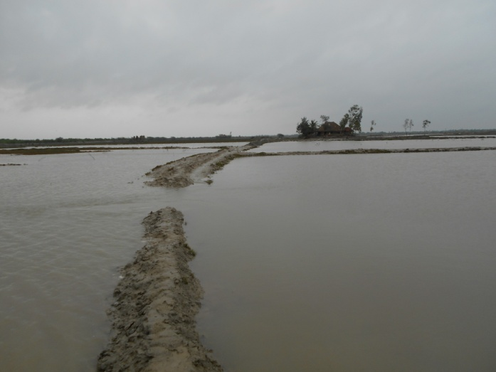
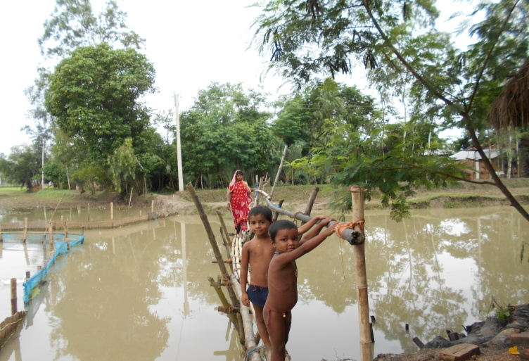
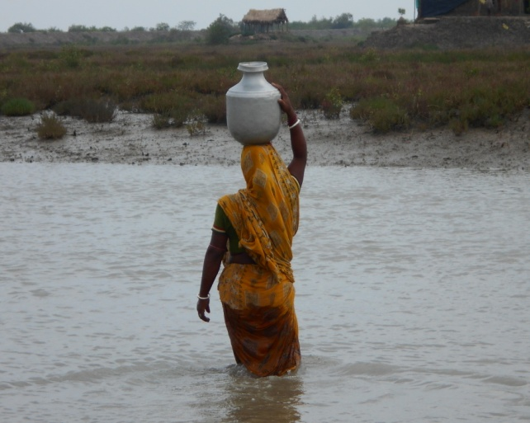
Barriers in accessing existing health system and other resources
The mothers and children has to precariously cross this water body on this bamboo pole. It becomes more difficult after sunset and if the mother is carrying a child in her arms
The women have to regularly cross this water logged portion to access potable water.
This is the situation of the road leading towards the health centre during high tide

Slide 6
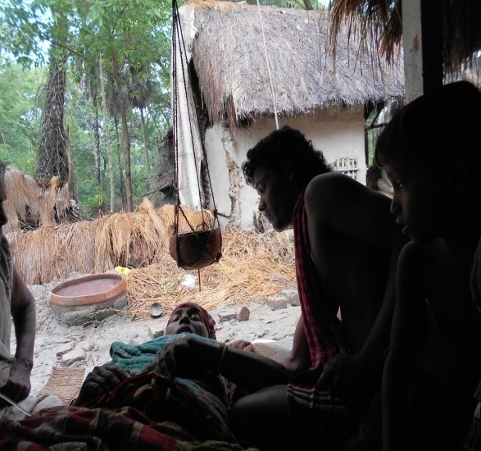
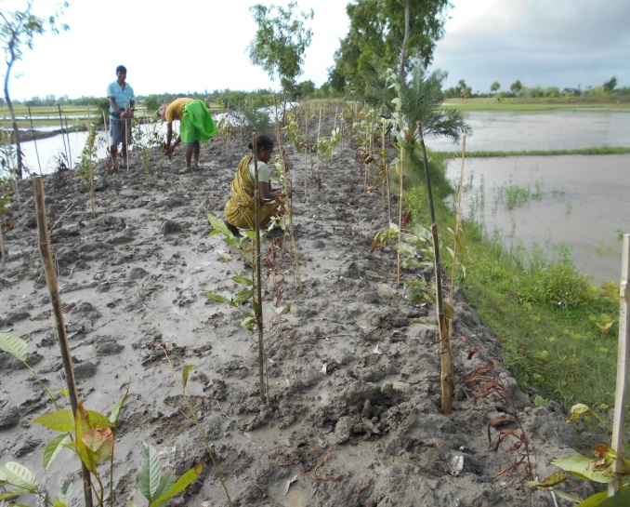
Adaptive strategies taken by the communities to cope with
I leave my younger child with the elder one. I know it is very risky but we do not have option
It is common to take help of traditional healing techniques for common ailments like fever.
We plant mangrove to give a support to the embankments

Slide 7
Major initiatives in both the countries
Salinity resistant crops
Brackish Aquaculture
Crab cultivations
Commercial prawn culture
Aqua-geophonics
Green Collage
Sack-garden
Training of girls and women for alternative livelihood
Participatory Research and Ownership with Technology, Information and Change (PROTIC)

Slide 8
What we still don’t know
Extent of impact on health and nutrition
What people really need?
How much the health system can bear the shock?

Slide 9
Study links:
https://opendocs.ids.ac.uk/opendocs/bitstream/handle/123456789/13823/FHS_IssueBrief1_Sundarbans.pdf?sequence=15&isAllowed=y
http://www.ids.ac.uk/publication/bringing-together-voices-to-address-climate-change-uncertainty-in-the-indian-sundarbans
https://opendocs.ids.ac.uk/opendocs/bitstream/handle/20.500.12413/14327/CCH%20Report_Final%20version_UG%20revisions.pdf?sequence=3&isAllowed=y
www.futurehealthsystems.org/publications/sundarbans-health-watch-series-1-how-healthy-are-the-childre.html
https://www.ncbi.nlm.nih.gov/pmc/articles/PMC5123342
https://www.researchgate.net/publication/321108568_Climate_change_health_effects_and_response_in_South_Asia
https://www.thelancet.com/pdfs/journals/lanplh/PIIS2542-5196(18)30088-3.pdf
https://www.researchgate.net/publication/323573020_Sundarbans_Living_on_the_Edge_Climate_Change_and_Uncertainty_in_the_Indian_Sundarbans
https://www.youtube.com/watch?v=efilYVB8YRc

