Slide 1
Richa Syal
Malaysia’s judges throw the book at wildlife criminals
How court data uncovered new trends in Malaysian wildlife convictions

Slide 2
Were Malaysian courts issuing heavier penalties for wildlife crime?
Three separate legislations:
Peninsular Malaysia: Wildlife Conservation Act 2010 (Act 716)
Sabah: Wildlife Conservation Enactment 1997
Sarawak: Wildlife Protection Ordinance 1998
Three types of data collection:
Court data
Media reports
Local NGOs

Slide 3
Barriers & challenges with the data
Official court data is scarce
Lack of public access
General hesitation by prosecutors to share
Case tracking takes time and resources

Slide 4
What the data showed
Court reports:
Common reference to PP v. Nguyen Thi Huong (2014)
Higher judge awareness on severity of wildlife crime
Significant increases in fines:
Nov 2015 - possession of clouded leopard: RM50,000
April 2019 - possession of clouded leopard: RM100,000 + 2 years jail

Slide 5
Lessons on using data skills to enhance investigative reporting
Look for ‘common denominators’
Identify quantitative change
Verify with experts
Humanize the numbers
Be transparent on the gaps both in the story and in the data
Support further reporting by keeping your data open-source!

Slide 6
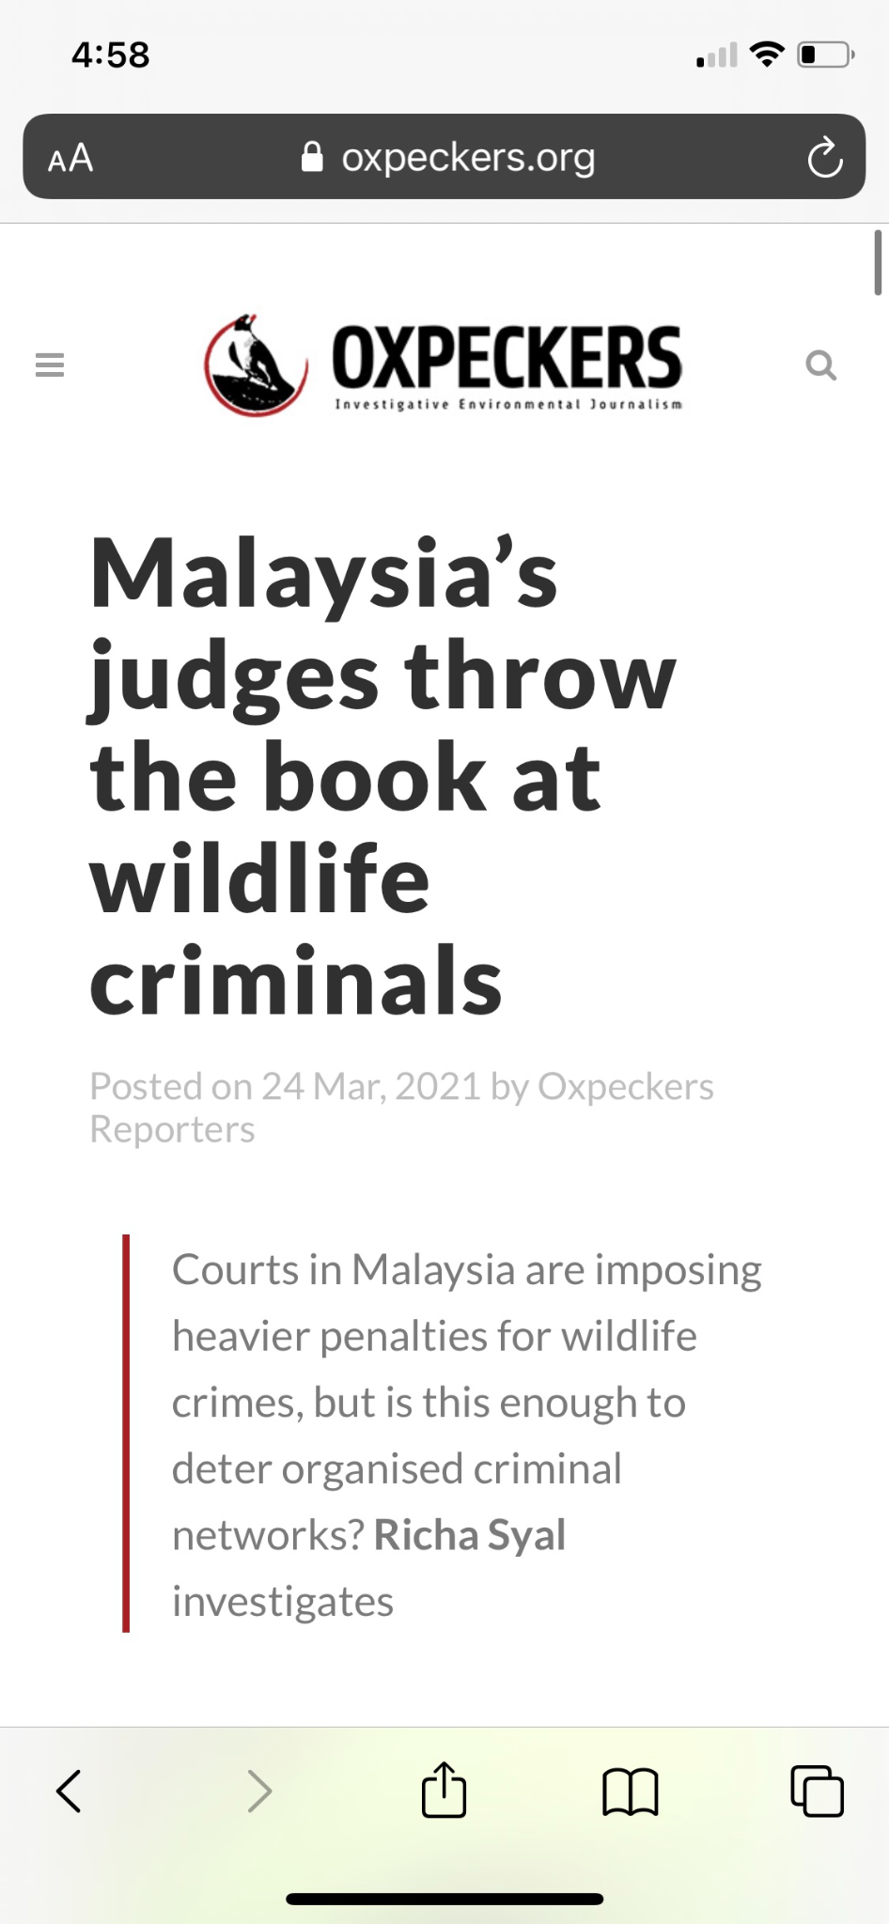
Thanks for listening!
Contact:
richasyal@gmail.com
Link to article:
https://oxpeckers.org/2021/03/malaysias-judges/

