Slide 1
Vietnam's criminals getting off lightly
Are Vietnam's laws strict enough to crack down on wildlife crime?
Vo Kieu Bao Uyen
Freelance journalist, Vietnam

Slide 2
Challenges
Government database was unhelpful:
Messy
Delayed updates or sometimes even no update
Difficult to navigate/find;
Information was not shared publicly;
Government not open to foreign media.

Slide 3
How we did it
Search and collate data from multiple sources
Education for Nature - Vietnam (ENV)
The library of law
Local media
Supreme People's Court of Vietnam
Categorize the data
First instance and Appellate
Note the serious cases

Slide 4
Analysed the data
Numbers alone do not tell a story
Compared cases before and after new Vietnamese Criminal Law came into effect
How many cases were tried?
What was the average prison sentence?
How much were criminals fined?
Dig up the serious (big) cases
Reading the official's wildlife case papers in the Court magazine, which is published in the Vietnam court system
=> Although the law was harsh on paper, in reality punishments were too lenient for the level of criminal activity.

Slide 5
Visualizing the data
Chart
Categorize
Pin on map (#WildEye Asia)

Slide 6
So, are the laws enough?
2015-2020: 552 wildlife crime cases prosecuted;
After new criminal law came into effect (2018), number of cases increased by 44%;
Legal experts rated current regulations as "comprehensive enough" to meet national goals of wildlife crime prevention;
Implementation is now needed
Use of relevant laws & regulations
Eradicate corruption
Focus on and arrest "tycoons" or "kingpins"

Slide 7
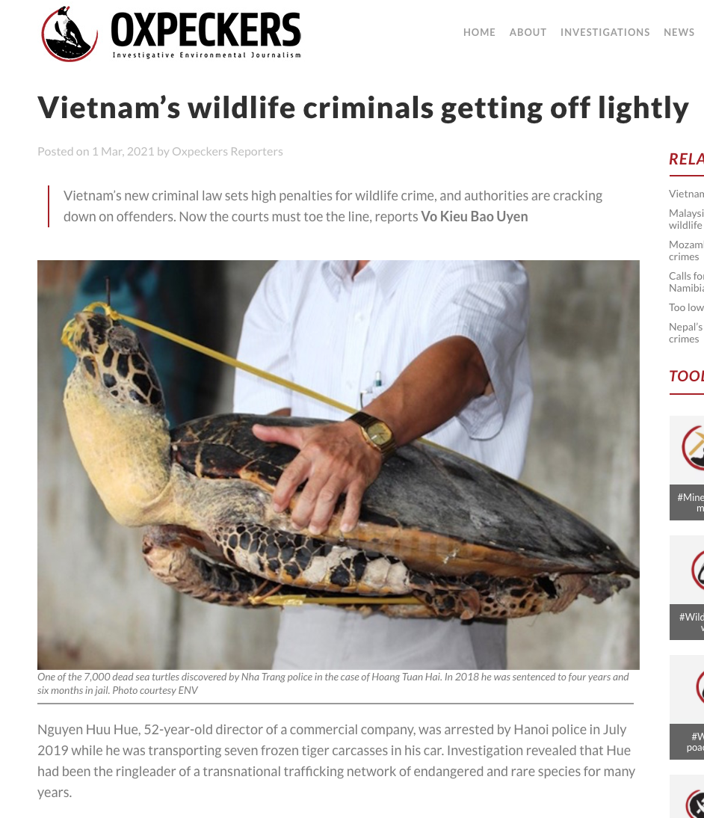
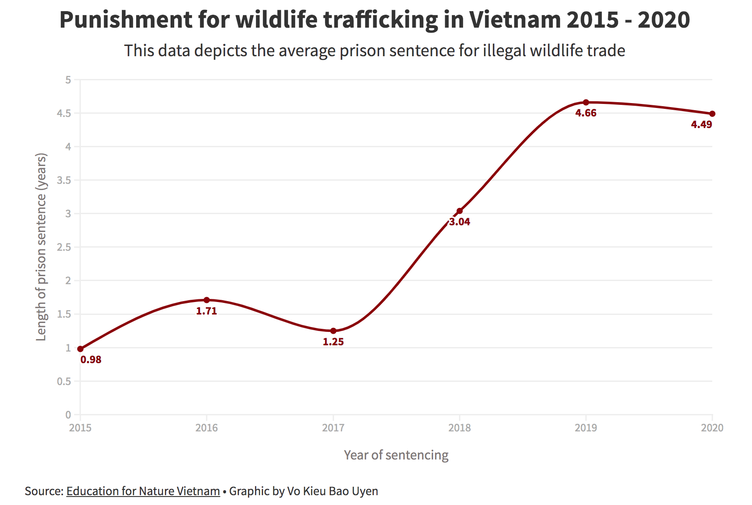
Link to article: bit.ly/3pYh1us
Contact: baouyenvk@gmail.com

