Slide 1
What we learnt from the #WildEye project in Asia

Slide 2
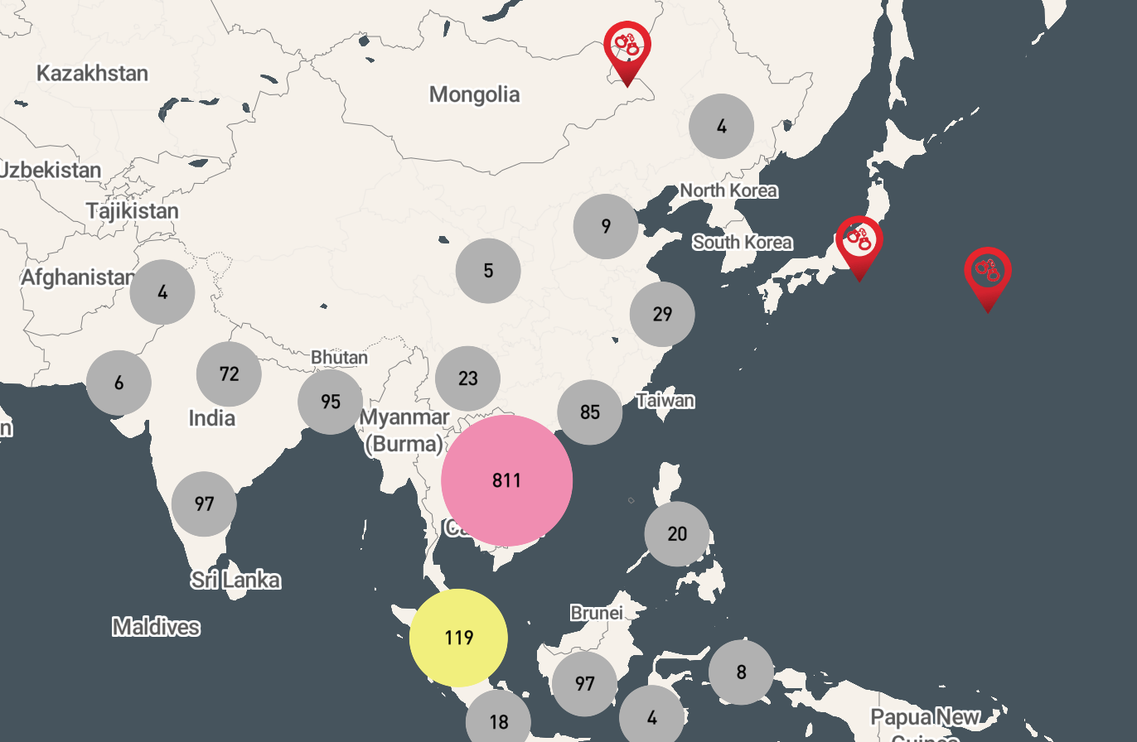
What is #WildEye?
Maps seizures, arrests, court cases and convictions of illegal wildlife trafficking;
Developed by journalists for journalists;
Created our own datasets (multiple sources) → made them accessible;
Personalised access to data;
Analysis, research and storytelling;
Until now, no single place to access information easily on crackdown on wildlife crime;
#WildEye addresses the gap → sharing data on justice in action

Slide 3
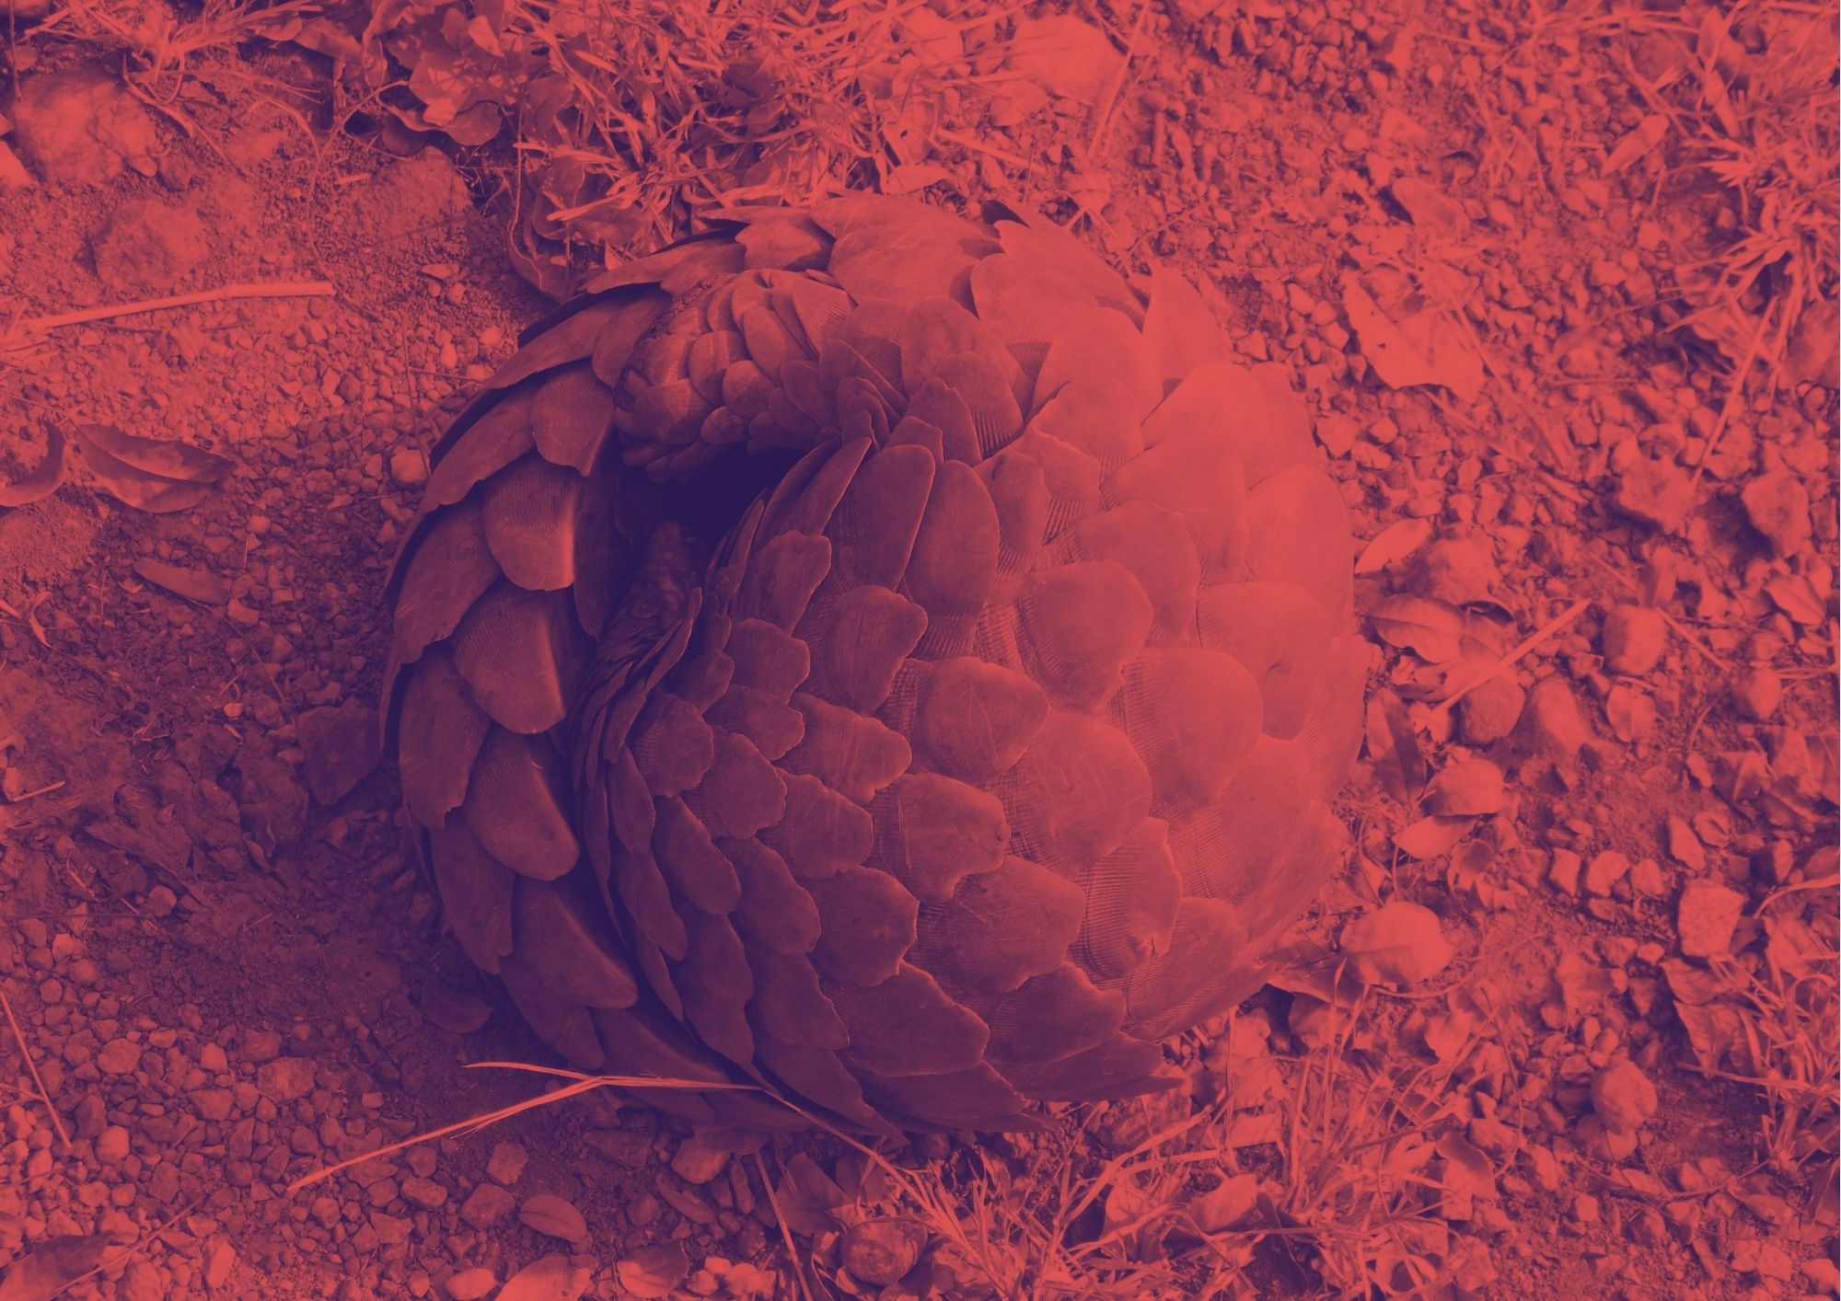
Let the numbers do the talking
14
600+
2,000
A total of 14 data-driven investigations were published in 8 different countries
Engaged with more than 600 people (many journalists) through workshops and webinars
Nearly 2,000 data points were added to the #WildEye Asia map

Slide 4
#WildEye investigations
Jhesset Enano, Philippines
Sadiq Naqvi,
India
Vo Kieu Bao Uyen, Vietnam

Slide 5
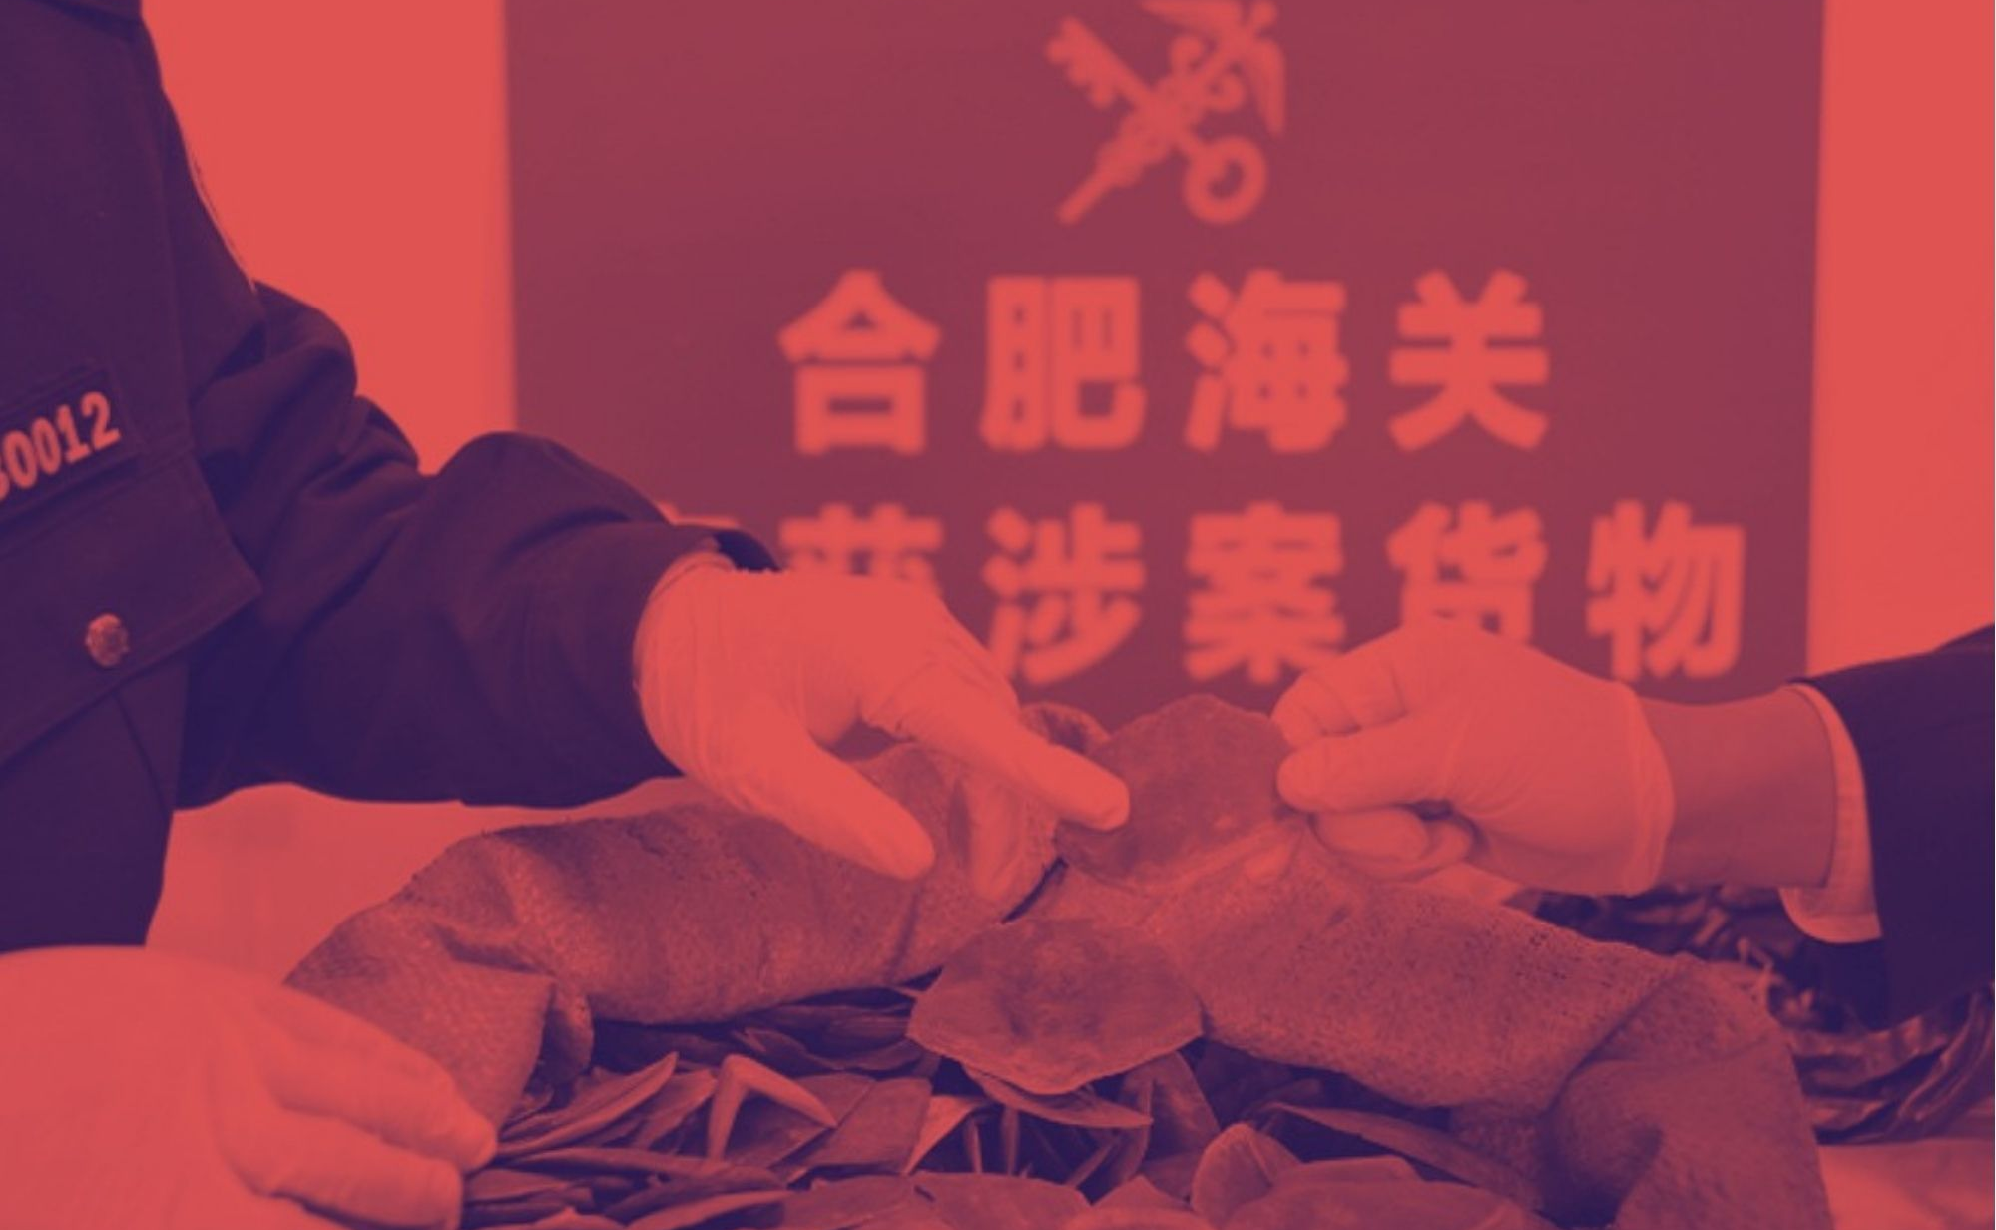
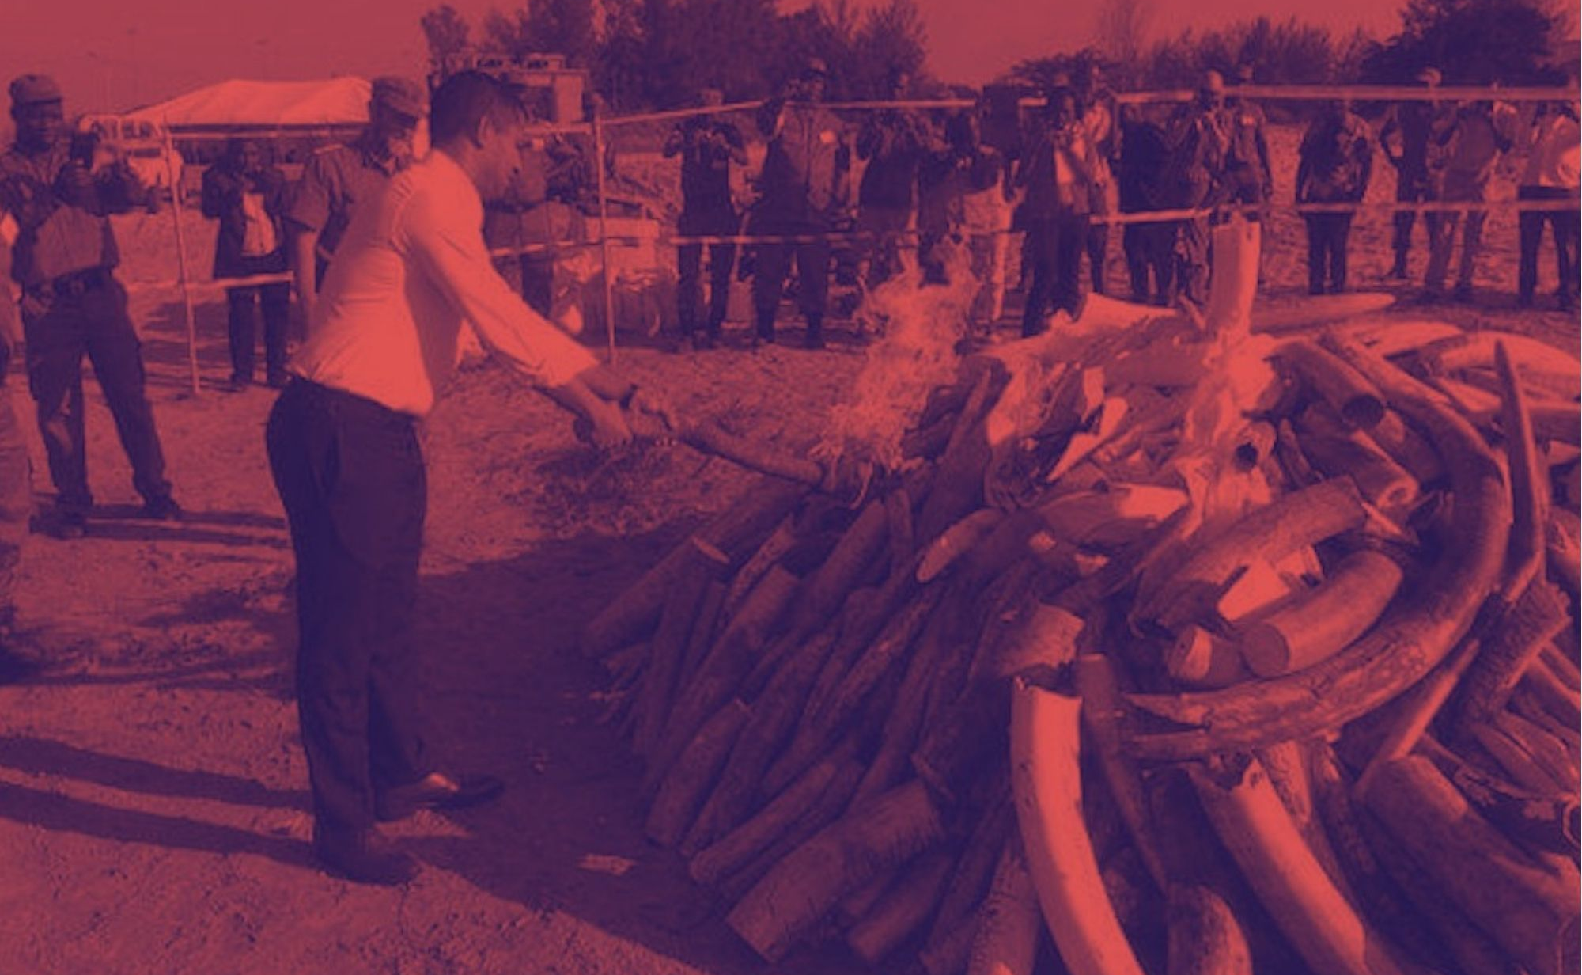
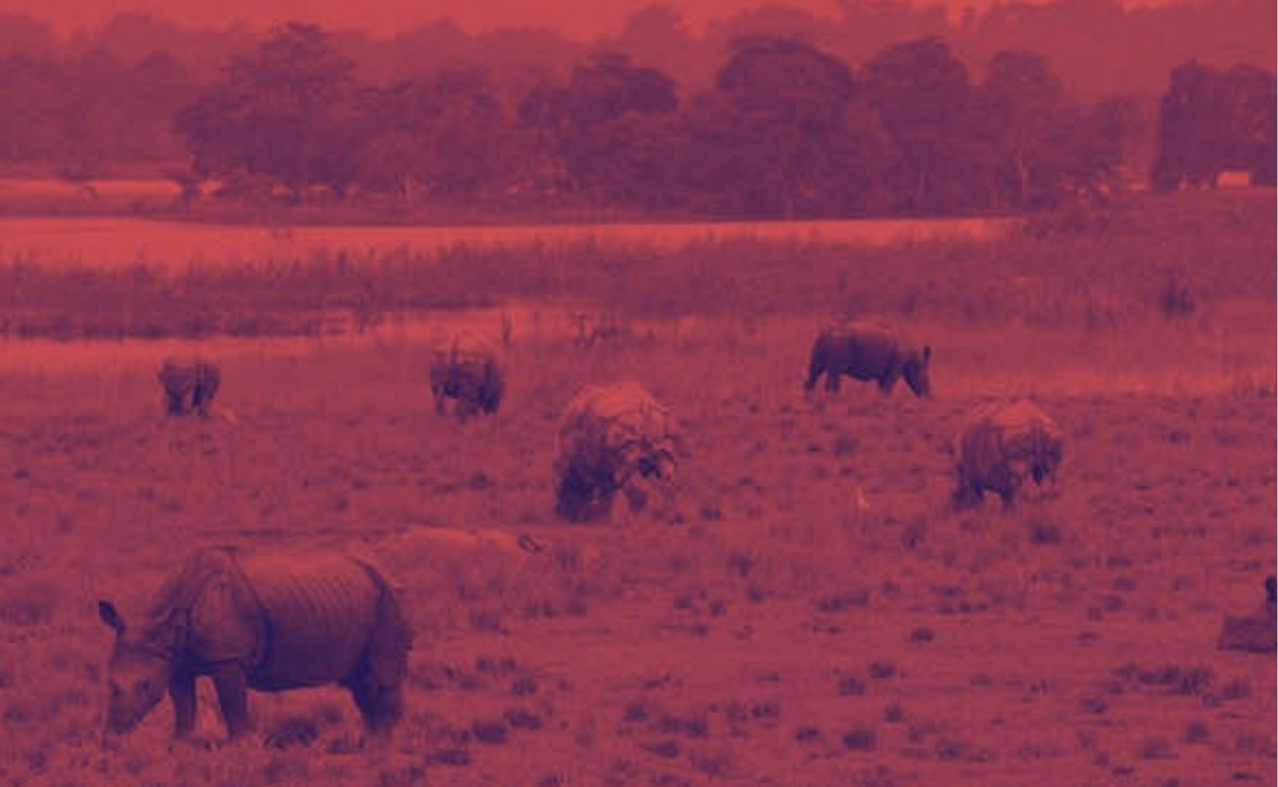
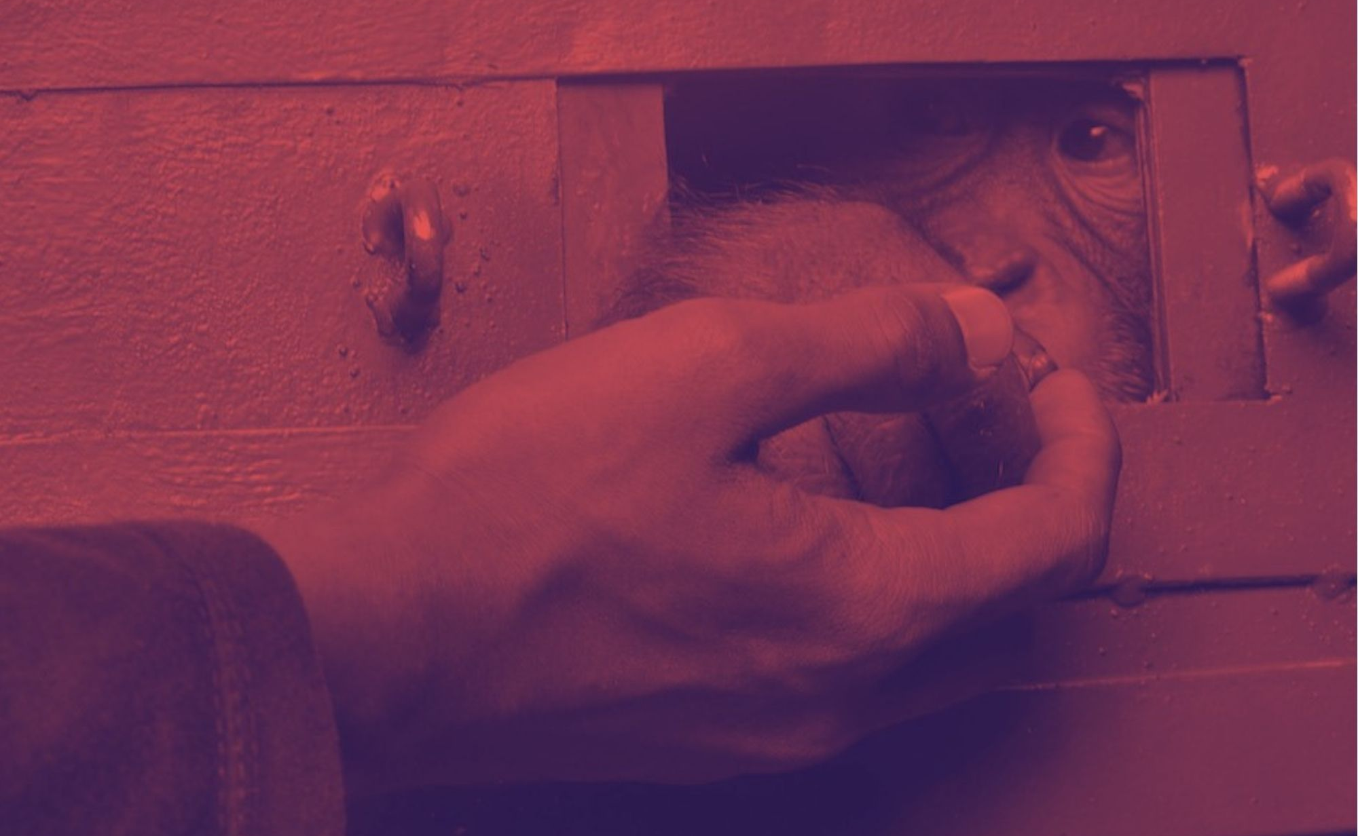
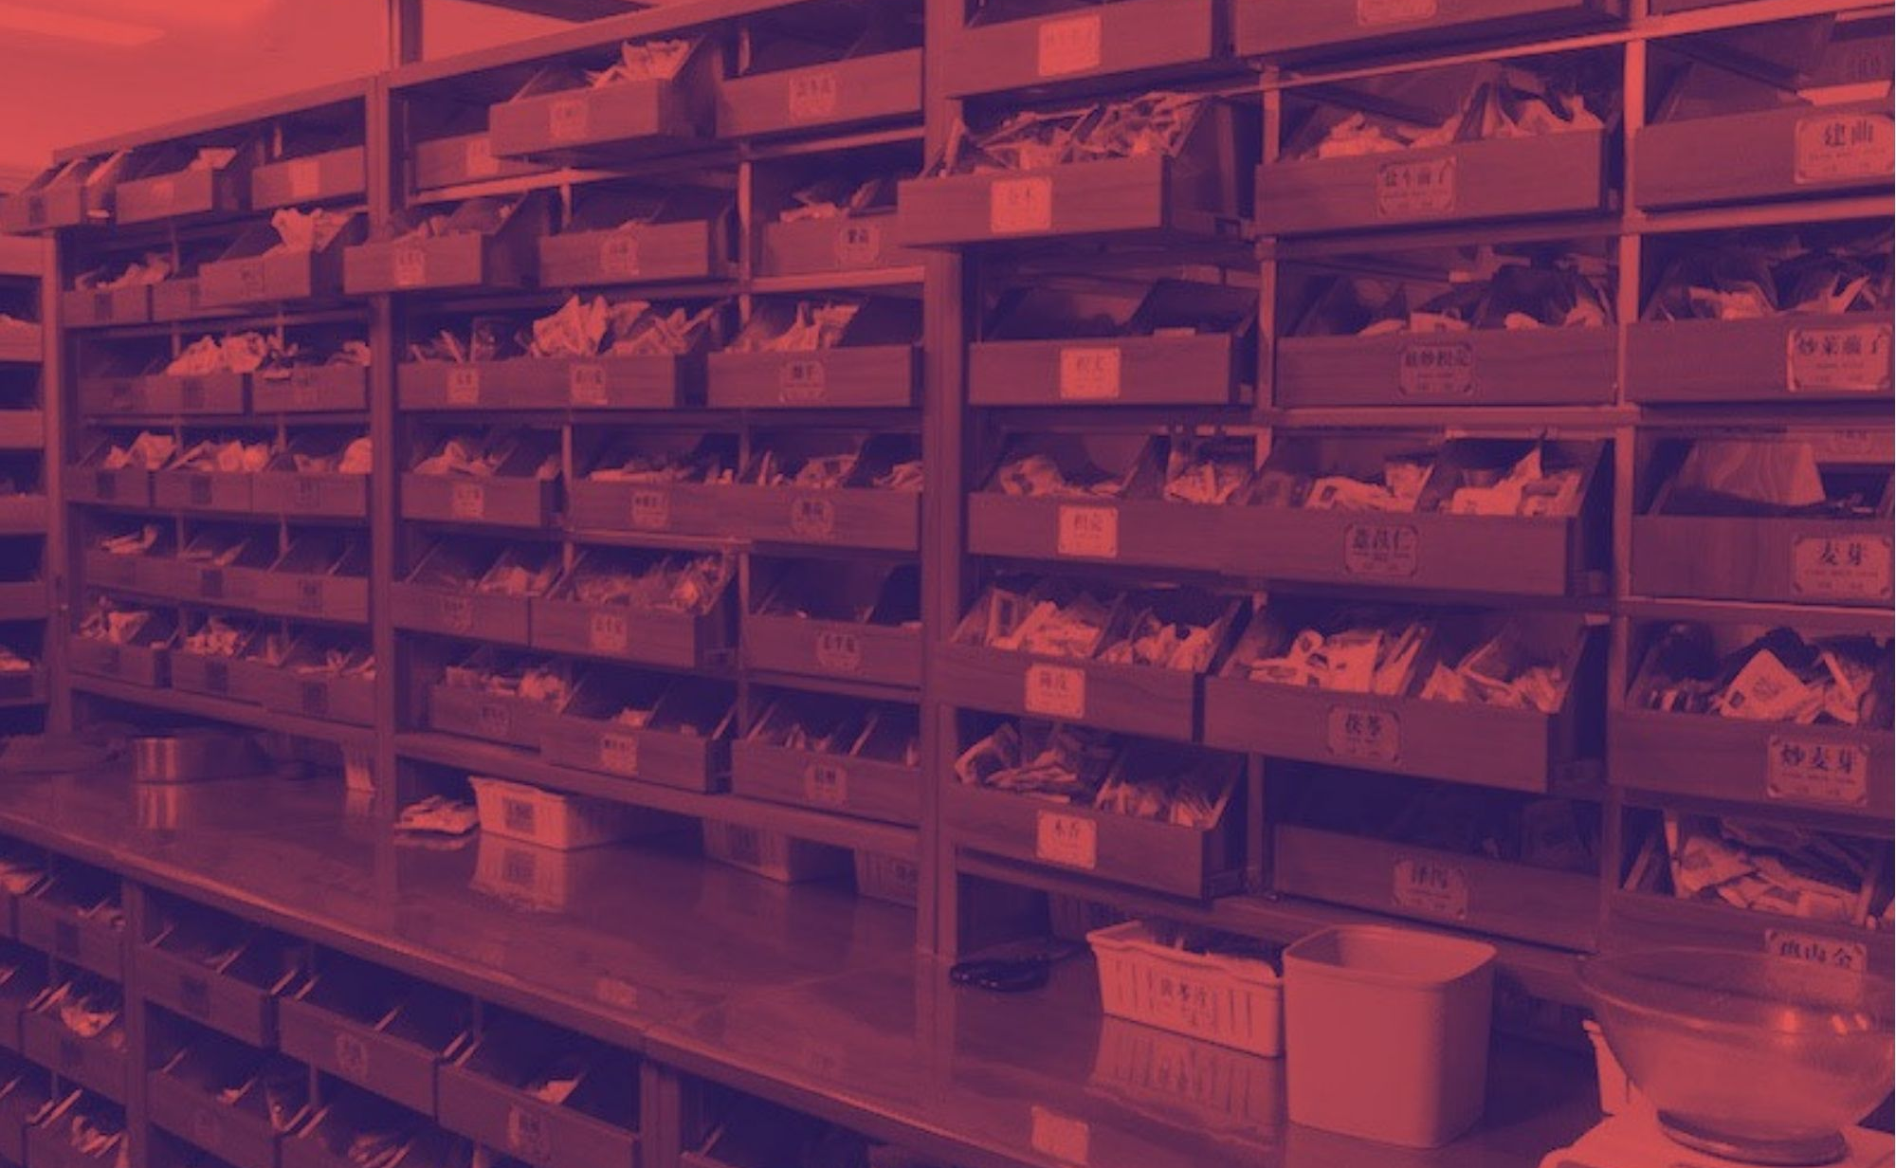
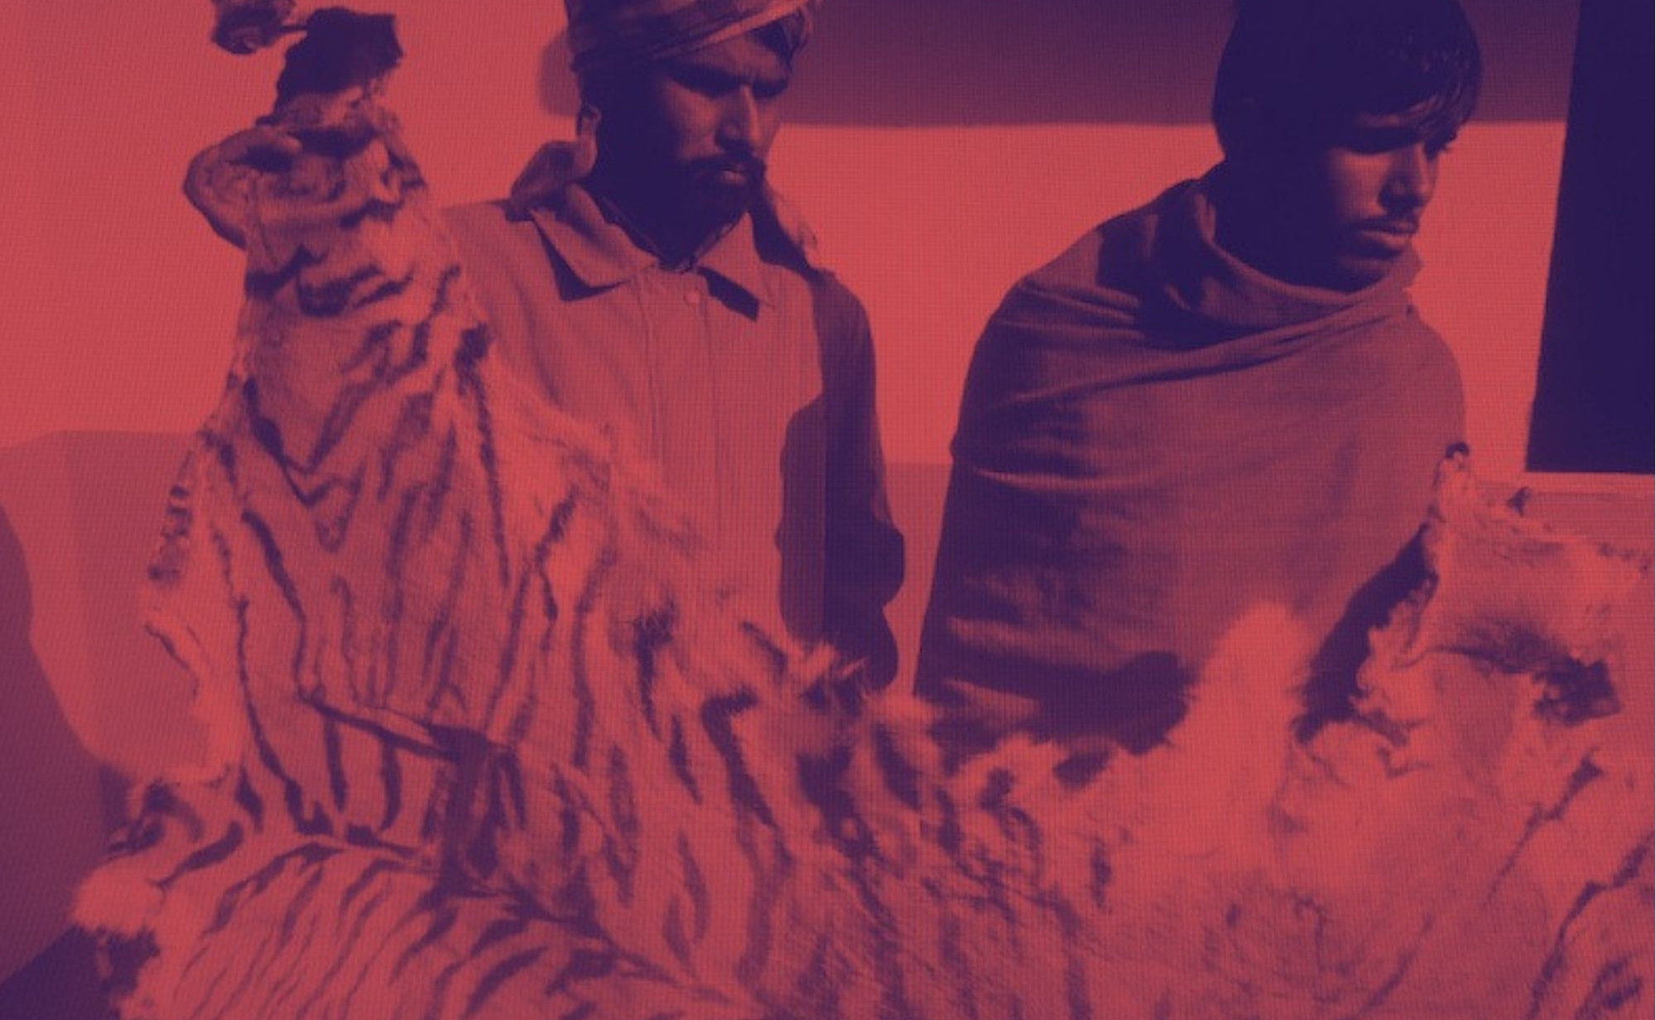
Chinese courts treat pangolin offenders lightly
China urged to burn stockpiles of pangolin scales
Insurgents linked to India's rhino poaching syndicates
New Indonesian law trumps wildlife smugglers
Wildlife has no part in TCM, say Chinese doctors
Nepal's courts in the dock over tiger crimes
Notes:
Note: We will only be speaking to some of the grantees who produced work for the project, but not all of them could join us today

Slide 6
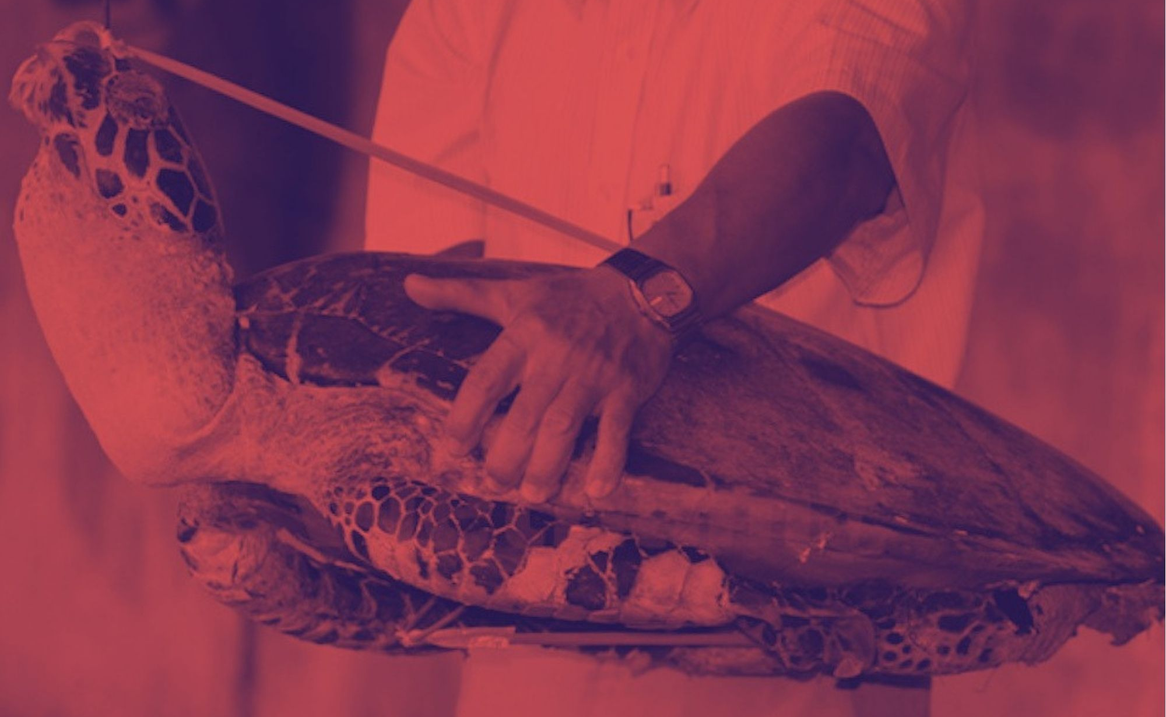
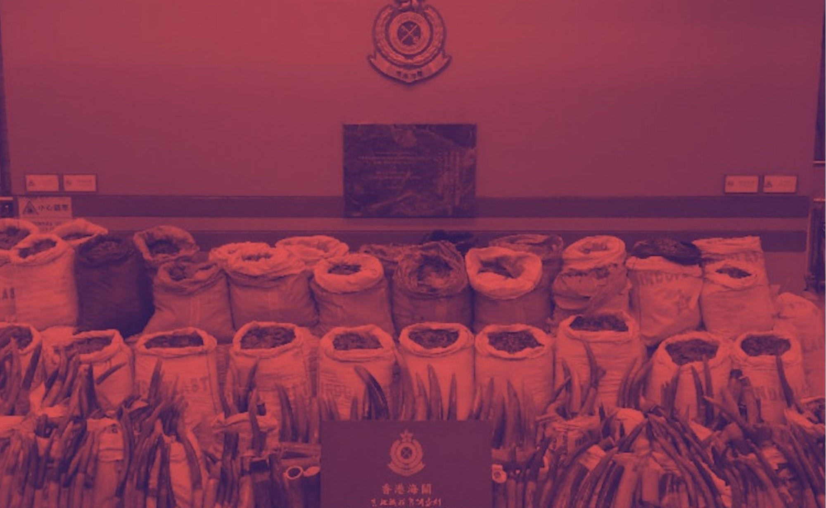
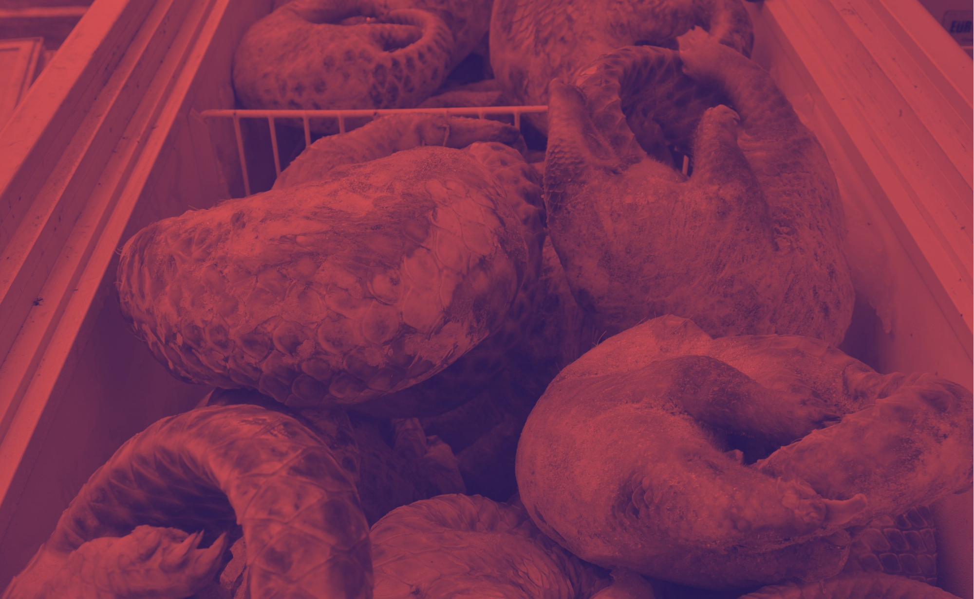
Vietnam's wildlife criminals getting off lightly
Malaysia's judges throw the book at wildlife criminals
Business as usual for Hong Kong's wildlife masterminds
Philippine wildlife criminals get away with a slap on the wirst

Slide 7
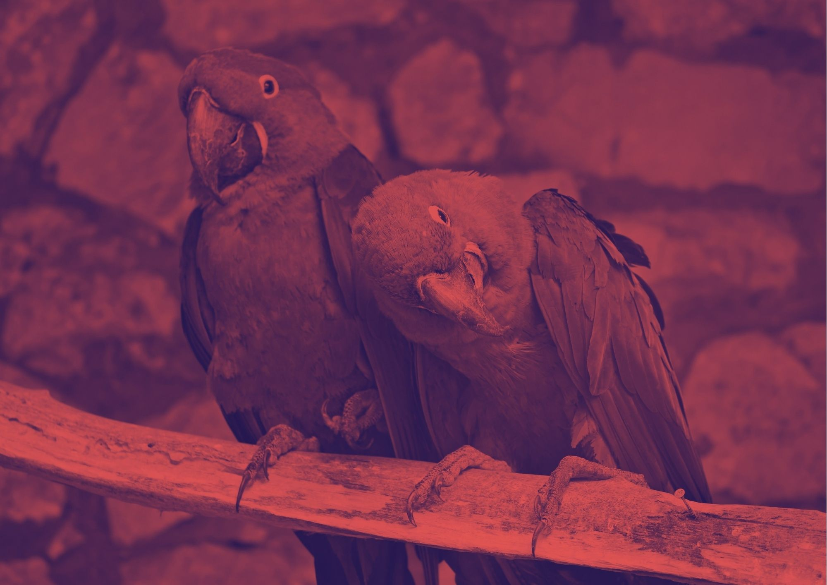
#WildEye data
Wan Ulfa Nur Zuhra, Indonesia
Richa Syal, Malaysia/UAE
Rezza Aji Pratama, Indonesia

Slide 8
The data is the story
47%
1,500+
5 yrs
The majority of incidents mapped were based in Vietnam.
Over 1,500 different items seized, including ivory (130+), live pangolins (90+), rhino horns (80+) and pangolin scales (66+).
The average sentence handed down to criminals was 5 years' imprisonment (25+), followed by 1 year (30+) and 10 years (10+).

Slide 9
Partnerships & collaborations

Slide 10
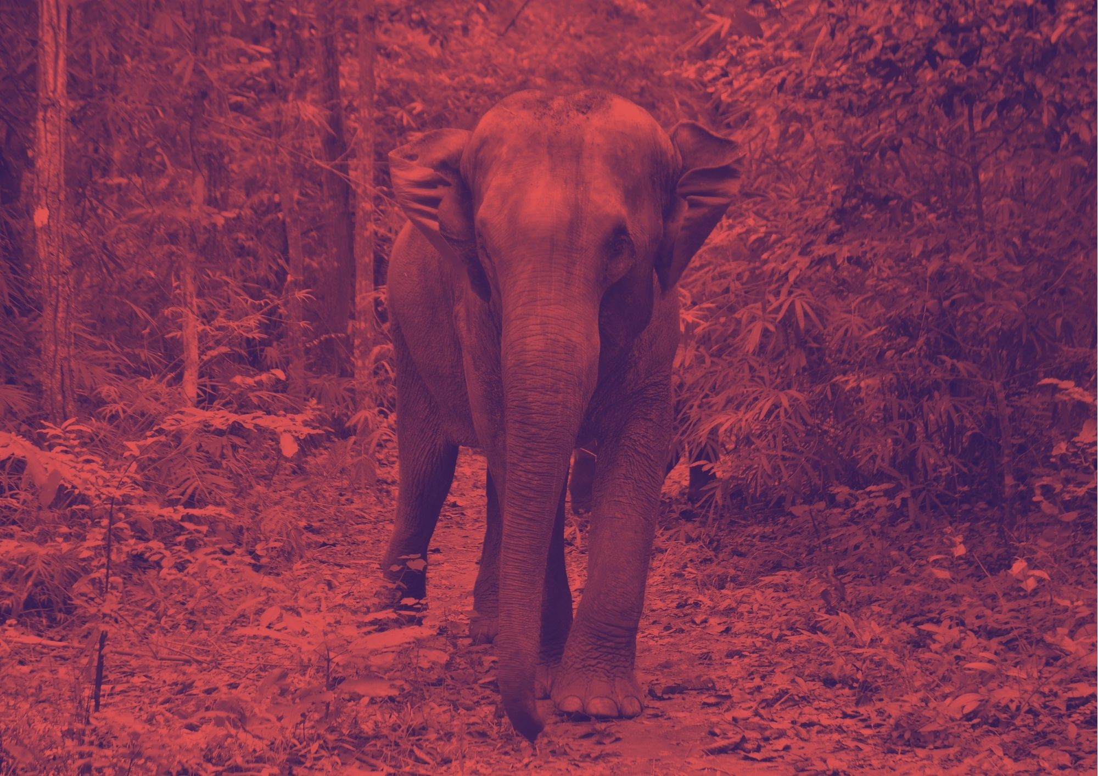
#WildEye engaged, partnered & collaborated with more than 50 organisations
ASEAN Centre for Biodiversity, Chinadialogue, Climate Tracker, European Union, Indonesian Data Journalism Network (IDJN), Mongabay, Pacific Environment Journalists Network, Pacific Media Centre, Society of Indonesian Environmental Journalists (SIEJ), Thai Society of Environmental Journalists, The Swedish International Development Cooperation Agency (Sida), USAID, Wildlife Conservation, Society-India, Wildlife Conservation Society-Vietnam, Environmental Reporting Collective, Haluan.co, Open Development Mekong, Wildlife Justice Commission, TRAFFIC, Trace Network, African Investigative Journalism Conference, Wits Journalism, Education for Nature - Vietnam (ENV), Global Initiative against Transnational Organized Crime, ADM Capital Foundation, UNODC Wildlife Crime Research Unit, Nguoi Do Thi Online, Philippine Daily Inquirer, Michigan State University, French Media Development Agency, ENV Knowledge Hub, Alliance to Counter Crime Online, Himal Khabar, Global Forest Watch, Environmental Investigation Agency, Organized Crime and Corruption Reporting Project, Third Pole, Deutsche Welle, Scroll.in, Ekuatorial, Wild Tiger, International Anti-Corruption Conference, Deutsche Gesellschaft fur Internationale Zusammenarbeit, Finnish Museum of Natural History, Four Paws, C4ADS, i of the Elephant, Earth League International, United Nations Office on Drugs and Crime & INTERPOL

Slide 11
Takeaways
Wildlife trafficking continues to thrive despite the pandemic
Some countries' laws & legislation are adapting to the situation
Kingpins seemingly always one step ahead

Slide 12
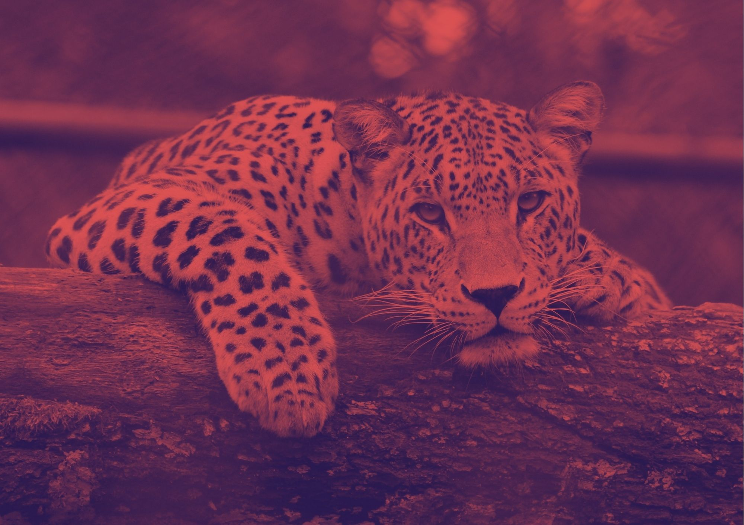
Takeaways
More resources + support available to law enforcement
More attention on wildlife trafficking and its links to zoonotic diseases
Concerted effort to crack down on wildlife crime

Slide 13
Takeaways
Liberated significant amount of data used by journalists + law enforcement
Growing interest in data journalism
Difficult to access data in some places

Slide 14
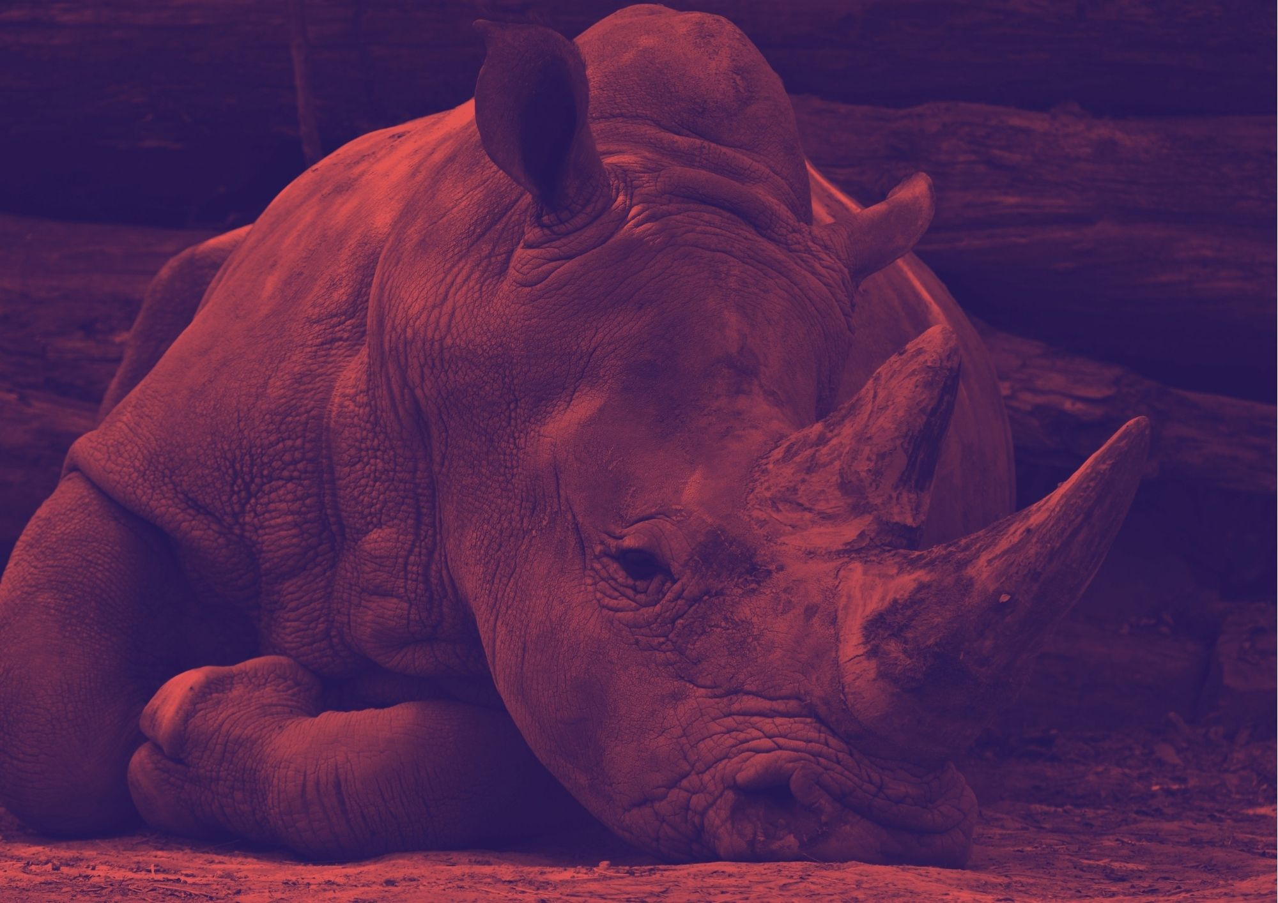
Thank you!

