Slide 1
ECOTECH
Made in India Technology
Zero-Residue Waste Conversion Plants
Pyrolysis based systems for converting unsegregated wastes.
Solution for Covid-19 related Waste Disposal Problems No Segregation , No Carbon Emissions , No Post-process residue Automatic and complete conversion of waste to Energy Products

Slide 2
Waste as a source of Renewable Energy
Renewable energy is useful energy that is collected from renewable resources, which are naturally replenished on a human timescale, including carbon neutral sources like sunlight, wind, rain, tides, waves, and geothermal heat. The humungous quantities of waste generated everyday and the emergence of technologies to utilize waste make it an ideal resource for renewable energy .
This type of energy source stands in contrast to fossil fuels, which are being used far more quickly than they are being replenished.
The world generates 2.01 billion tons of municipal solid waste annually, with at least 33 percent of that—extremely conservatively—not managed in an environmentally safe manner. Worldwide, waste generated per person per day averages 0.74 kilogram but ranges widely, from 0.11 to 4.54 kilograms.
Biomedical waste management during COVID-19 can pose severe health risks for waste pickers and people living near dumping sites and landfills. India witnessed an increase of 46% in biomedical waste due to COVID-19, with 139 tons per day in April 2021 and 203 tons per day in May 2021. However, the percentage of biomedical waste treated declined from 92.8% to 88%.

Slide 3
Importance of Plastic Waste Utilization
Plastic is one of the most successful manufacturing materials in post-world war era. It’s due to its high specific-strength, toughness, chemical inertness and cost-effectiveness.
On the other hand, global production of plastic material has increased more than 200-fold from 1950 to 2020.
Today over 100 million tons of plastic is produced annually on the world.
This excessive reliance on plastics oblige the need for plastic waste management .
This necessitates innovation in plastic waste management methods. Using Pyrolysis for Production of Biofuel is one such innovative method.
Conversion of Plastics to Biofuels
PP- upto 90%
PPE- upto 60%
PVC- upto 30%
PET – NIL ( can be safely converted but will not yield any by-product.

Slide 4
Working Plant at Visakhapatnam processing 10 TPD of unsegregated MSW
View of Pyrolysis Reactor & Shredding /Feeding System

Slide 5
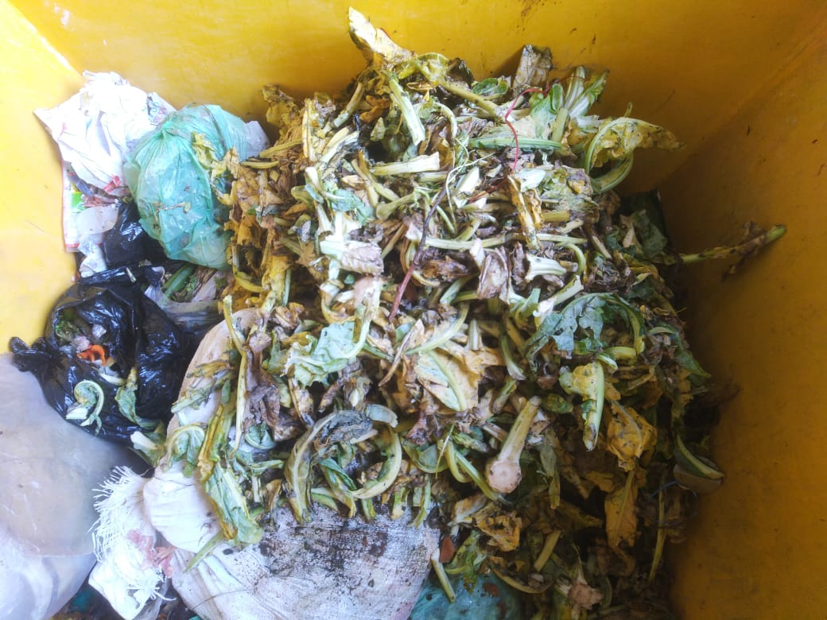
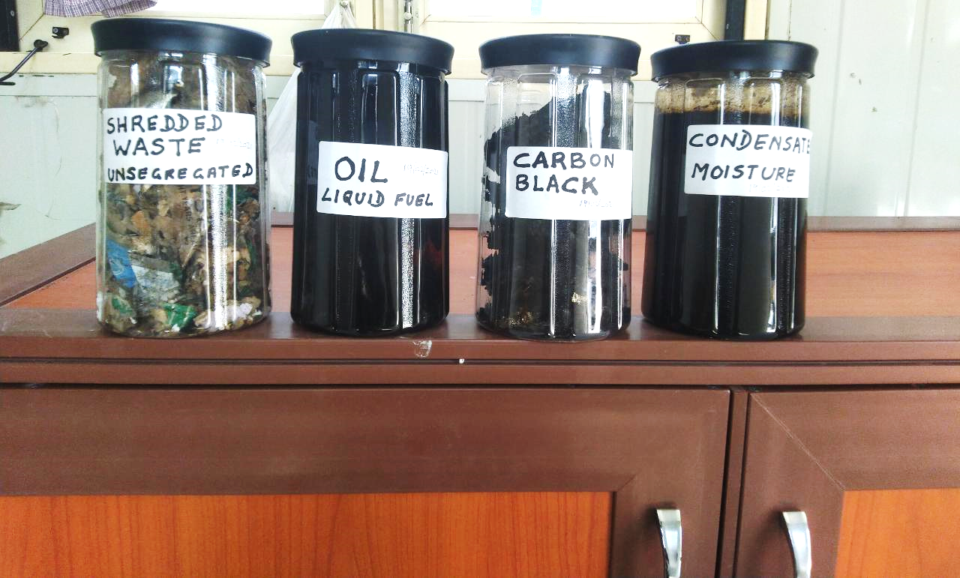
Input and Output of the Zero Residue Waste Conversion Plant Photographs below are from actual input and output at Visakhapatnam Plant May 2021.
BY-PRODUCTS DERIVED FROM THE WASTE
( Gas is collected in the Balloon )

Slide 6
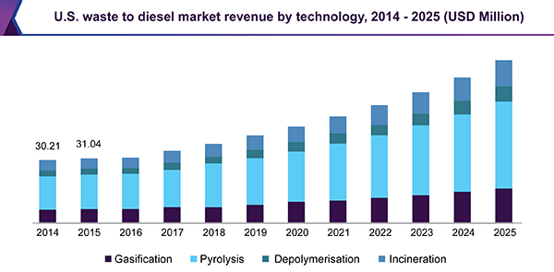
WASTE TO WEALTH - Industry Insights
Waste to Diesel Market Size, Share, Global Industry Report – upto 2025
The global waste to diesel market size was valued at USD 390 million in 2016. Globally, increasing demand from transportation, jet airways, construction, and automotive sector is projected to be a key factor driving market growth over the forecast period. Rising concern for recycle management is expected to propel the industry growth.
Immense application of diesel produced from waste in diesel boilers, ships, tractors & trucks, diesel power generators, and construction machinery among others is expected to boost the market over the next eight years. Stringent regulations by EPA concerning the hazardous effects of garbage are projected to propel the recycling industry over the coming period.

Slide 7
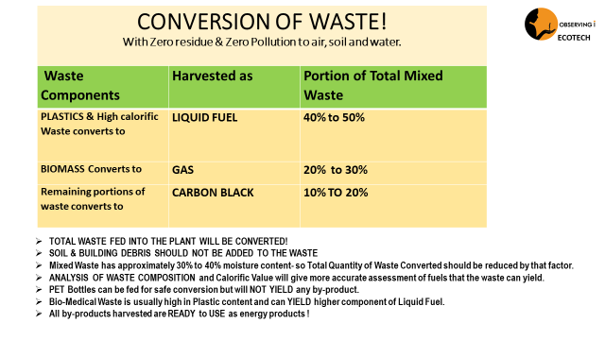

Slide 8
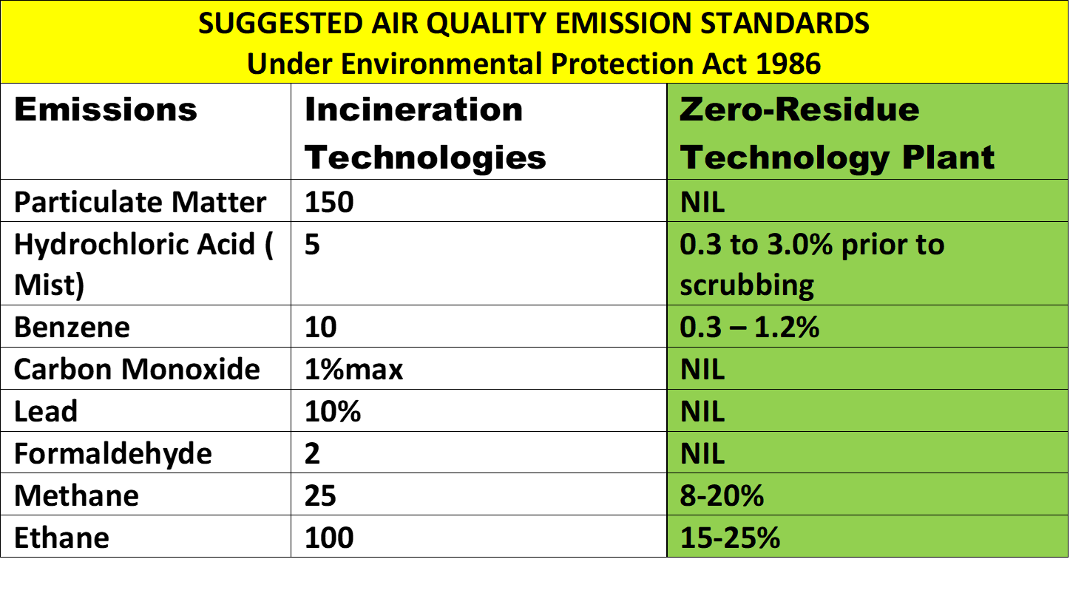

Slide 9
Why Pyrolysis based Plants are needed.
What are the Advantages of Pyrolysis?
The key benefits of pyrolysis include the following:
No Incineration of materials ; hence No post-process residue!
It is a simple technology for processing a wide variety of feedstocks.
It reduces waste going to landfill and greenhouse gas emissions.
It reduces the risk of air & water pollution.
It has the potential to reduce the country’s dependence on imported energy resources by generating energy from domestic resources.
Waste management with the help of modern pyrolysis technology is inexpensive compared to disposal to landfills.
The construction of a pyrolysis plant is a relatively rapid process.
It can provide low-cost energy products like Liquid Fuel, Gas and Bio-Char to support & sustain Rural and migrant populations. creates several new jobs for low-income people based on the quantities of waste generated in the region, which in turn provides public health benefits through waste clean up.

Slide 10
Some of the applications of Pyrolysis in Utilization of Waste
Bio-Medical waste having the largest component of non-biodegradable materials and huge risk in manual segregation is best utilized by processing in a Pyrolysis Plant.
Pyrolysis of Tyres is well known as the best solution for utilization of a huge quantity of discarded tyres.
Paper Industry for processing the waste largely comprising Plastic and cardboard.
Chemical industry to produce methanol, activated carbon, charcoal and other substances from wood.
E Waste to recover liquid fuels from large plastic content and significantly lower the quantity of material i.e. Bio-Char from which the valuable metals can be recovered.
Synthetic gas produced from the conversion of waste using pyrolysis can be used in gas or steam turbines for producing electricity.
A mixture of stone, soil, ceramics, and glass obtained from pyrolytic waste can be used as a building material - construction slag or for filling landfill cover liners.

Slide 11
OBSERVING I ECOTECH
OFFERS
ATMANIRBHAR BHARAT - SOLUTIONS TO POLLUTION !
Introduction
Observing I Ecotech is and Indian Company offering Proprietary Products. The Company specializes in providing SOLUTIONS TO POLLUTION!
Member of India Sanitation Coalition, Task Force for Best Practices - India Sanitation Coalition is an initiative by FICCI, put together to assist the Government in facilitation and proper implementation of the Swatch Bharat Mission and the Sansad Aararsh Gram Yojana (SAGY) programs.
Listed in SWACHH Portal of Urban Development Ministry of India
Business Development Associate of Indian Institute of Toxicology Research (IITR) Lucknow for sewage treatment technologies.
Consultant/Advisor at Malaviya Center for Innovation, Incubation and Entrepreneurship ( MCIIE), at Indian Institute of Technology ( IIT), BHU (Banaras Hindu University)
Charmaine Fernandes Sharma - Founder and Managing Partner of OIE is recognized for developing & commercializing Made in India products and technologies in the field of Biotechnology Research Apparatus, Enzyme solutions for Handloom industry etc.
AWARDED – 2021 Outstanding Entrepreneur Award - Sustainable Technologies 2021- Global Entrepreneurs Guild
AWARDED- (2002) Achievement Award in Biotechnology- Asia Pacific Convention of Entrepreneurial Women
Listed in Inventors List of India since 2009
Member India Sanitation Coalition - Task Force for Best Practices (India Sanitation Coalition is a body set up by FICCI to provide inputs in Sanitation, Environment Safety and Clean Technologies.
Mr. Ravi Nafde- Partner has designed, developed and optimized the Zero-Residue Waste Conversion Technology Plants.
Mr Nafde is recognized in India as a pioneer of Design & Engineering for Energy Recovery Plants.

Slide 12
Mission Statement: CLEAN THE WORLD, MAKE IT A BETTER PLACE for YOU and for ME and the ENTIRE HUMAN RACE!
Observing I Ecotech
Ph: +91 8874447222
Web: www.observingi.com
Email: charmaine@observingi.in

