Slide 1
Intergovernmental Panel on Climate Change (IPCC)
Internews workshop: Linking local to global policies and commitments
11 November 2021
Jonathan Lynn,
Head of Communications and Media Relations, IPCC

Slide 2
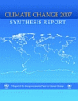
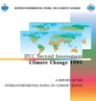
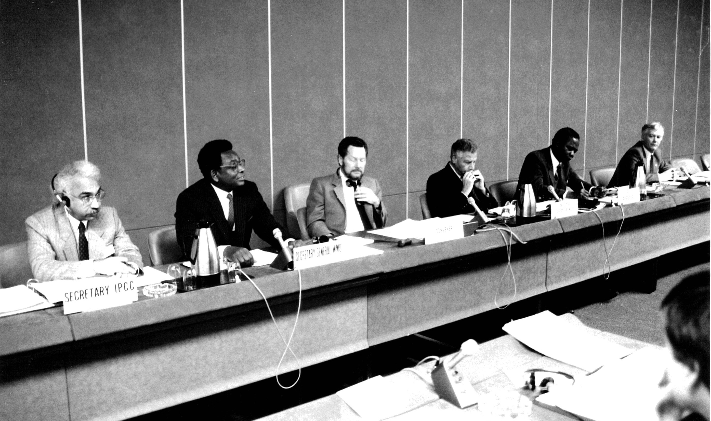
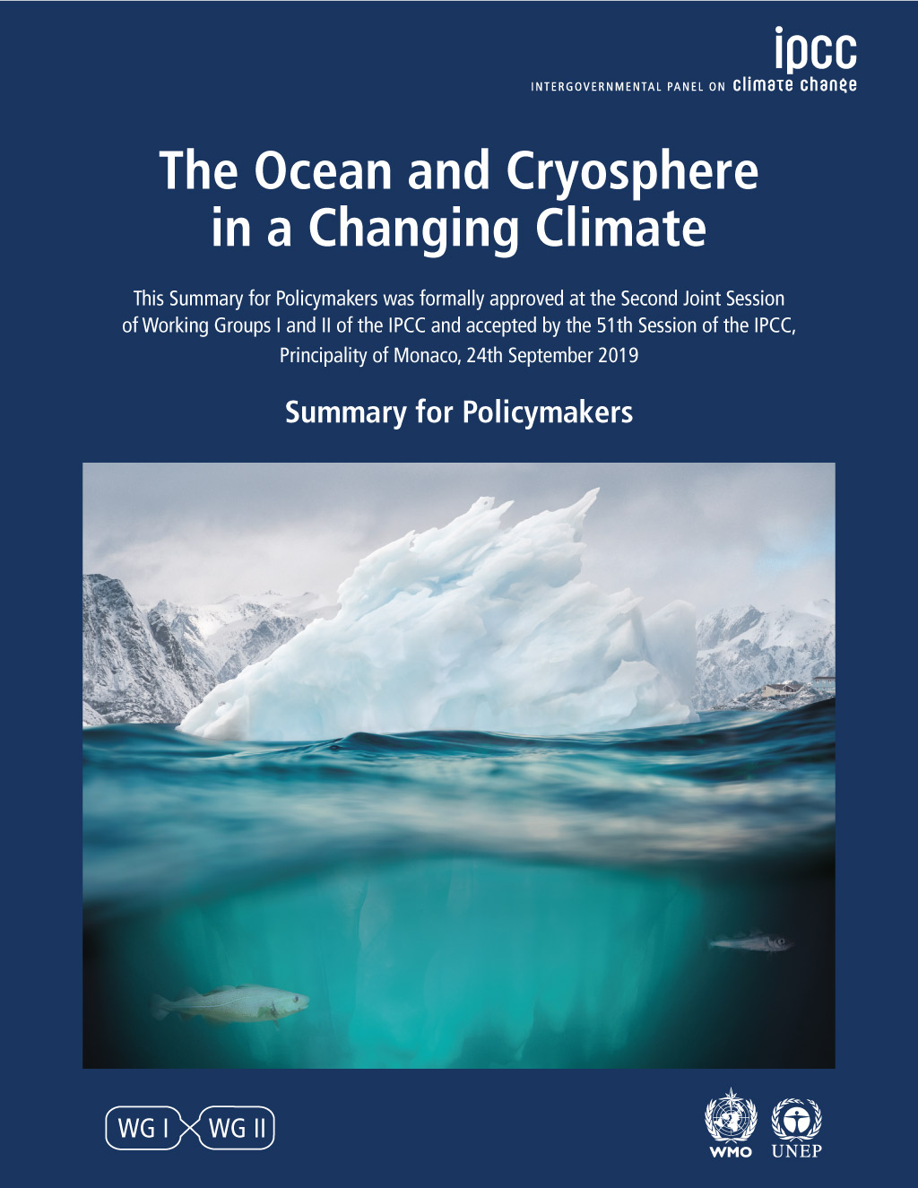
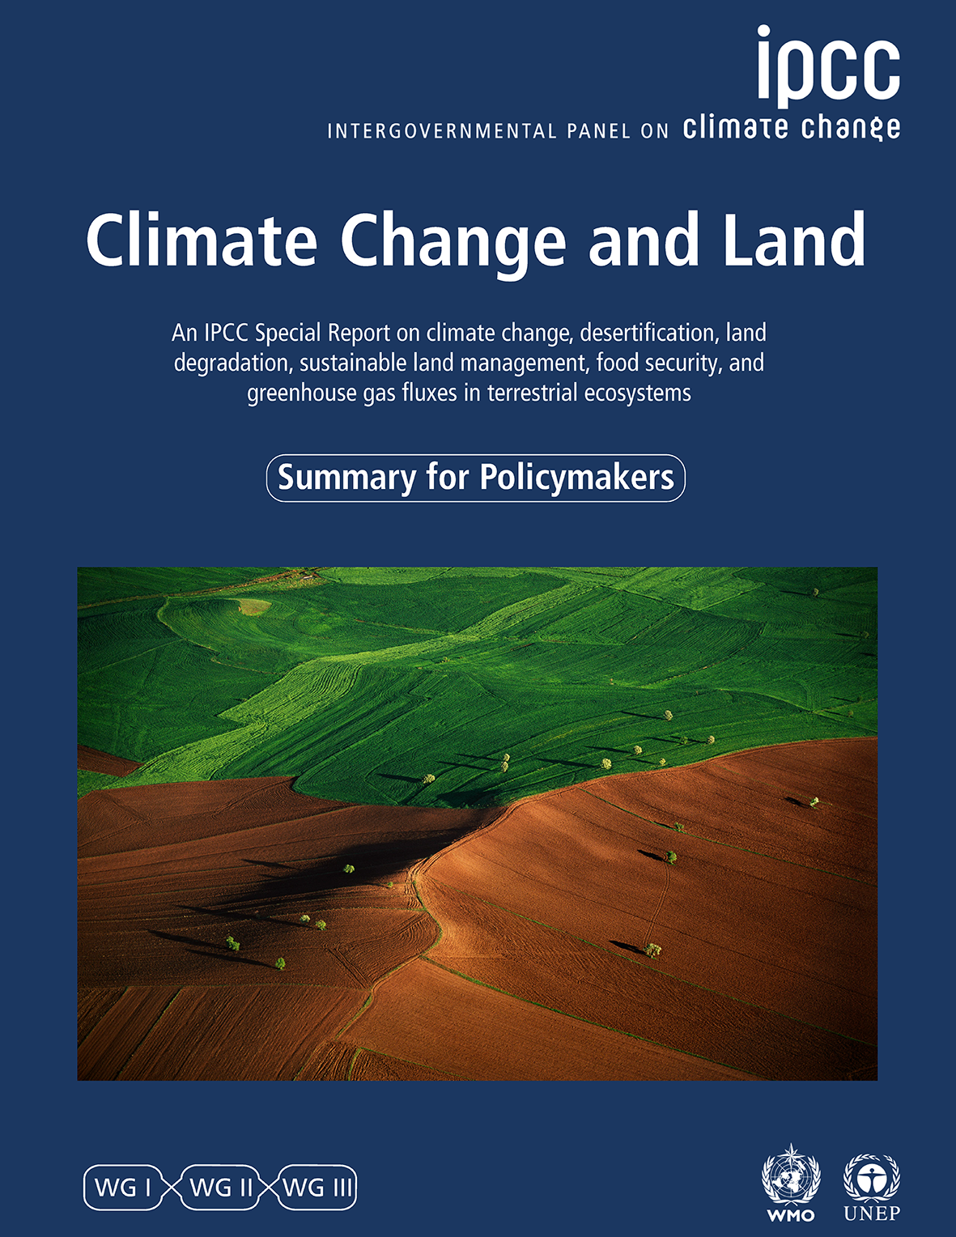
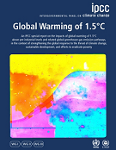

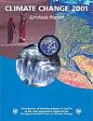
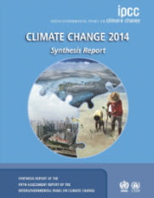
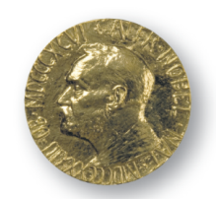
TAR
AR5
MR
AR4
SR15
FAR
AR6
SAR
UNFCCC
Adaptation
2 °C limit
Paris Agreement
SROCC
SRCCL
UNFCCC Global
Stocktake
Kyoto Protocol
IPCC – jointly
established by WMO and UNEP
Science of climate change ( exponential growth in peer-reviewed literature)
Growing public awareness
Involvement of various actors
Nobel Peace Prize
1988
1995
2007
2019
2018
2023
1970s-1980s
1990
2001
2013-2014
2021-2022

Slide 3
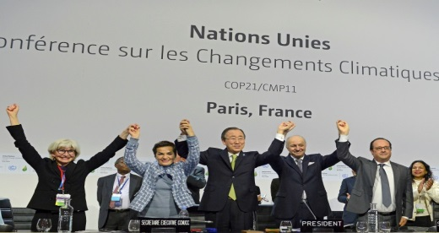
IPCC reports have made an impact
FAR (1990)
led to
UNFCCC
SAR (1995)
input for
Kyoto Protocol
TAR (2001)
focused attention on
Impacts of climate change and need for adaptation
AR4 (2007)
input for
Decision on 2ºC limit; basis for post Kyoto Protocol agreement
AR5 (2013/2014)
input for
SR15
input for
COP24/Talanoa Dialogue

Slide 4
The role of the IPCC is …
“… to assess on a comprehensive, objective, open and transparent basis the scientific, technical and socio-economic information relevant to understanding the scientific basis of risk of human-induced climate change, its potential impacts and options for adaptation and mitigation.”
“IPCC reports should be neutral with respect to policy, although they may need to deal objectively with scientific, technical and socio-economic factors relevant to the application of particular policies.”
Principles Governing IPCC Work, paragraph 2
Source: http://www.ipcc.ch/pdf/ipcc-principles/ipcc-principles.pdf

Slide 5
10 Steps in creating IPCC reports
1
Scoping
2
Approval of Outline
7
3
Final Draft report and SPM
Nomination of Authors
6
4
Govt and Expert Review SOD
Selection of Authors
5
8
Expert Review FOD
Govt Review of Final Draft SPM
9
Approval & acceptance of report
10
Publication of report

Slide 6
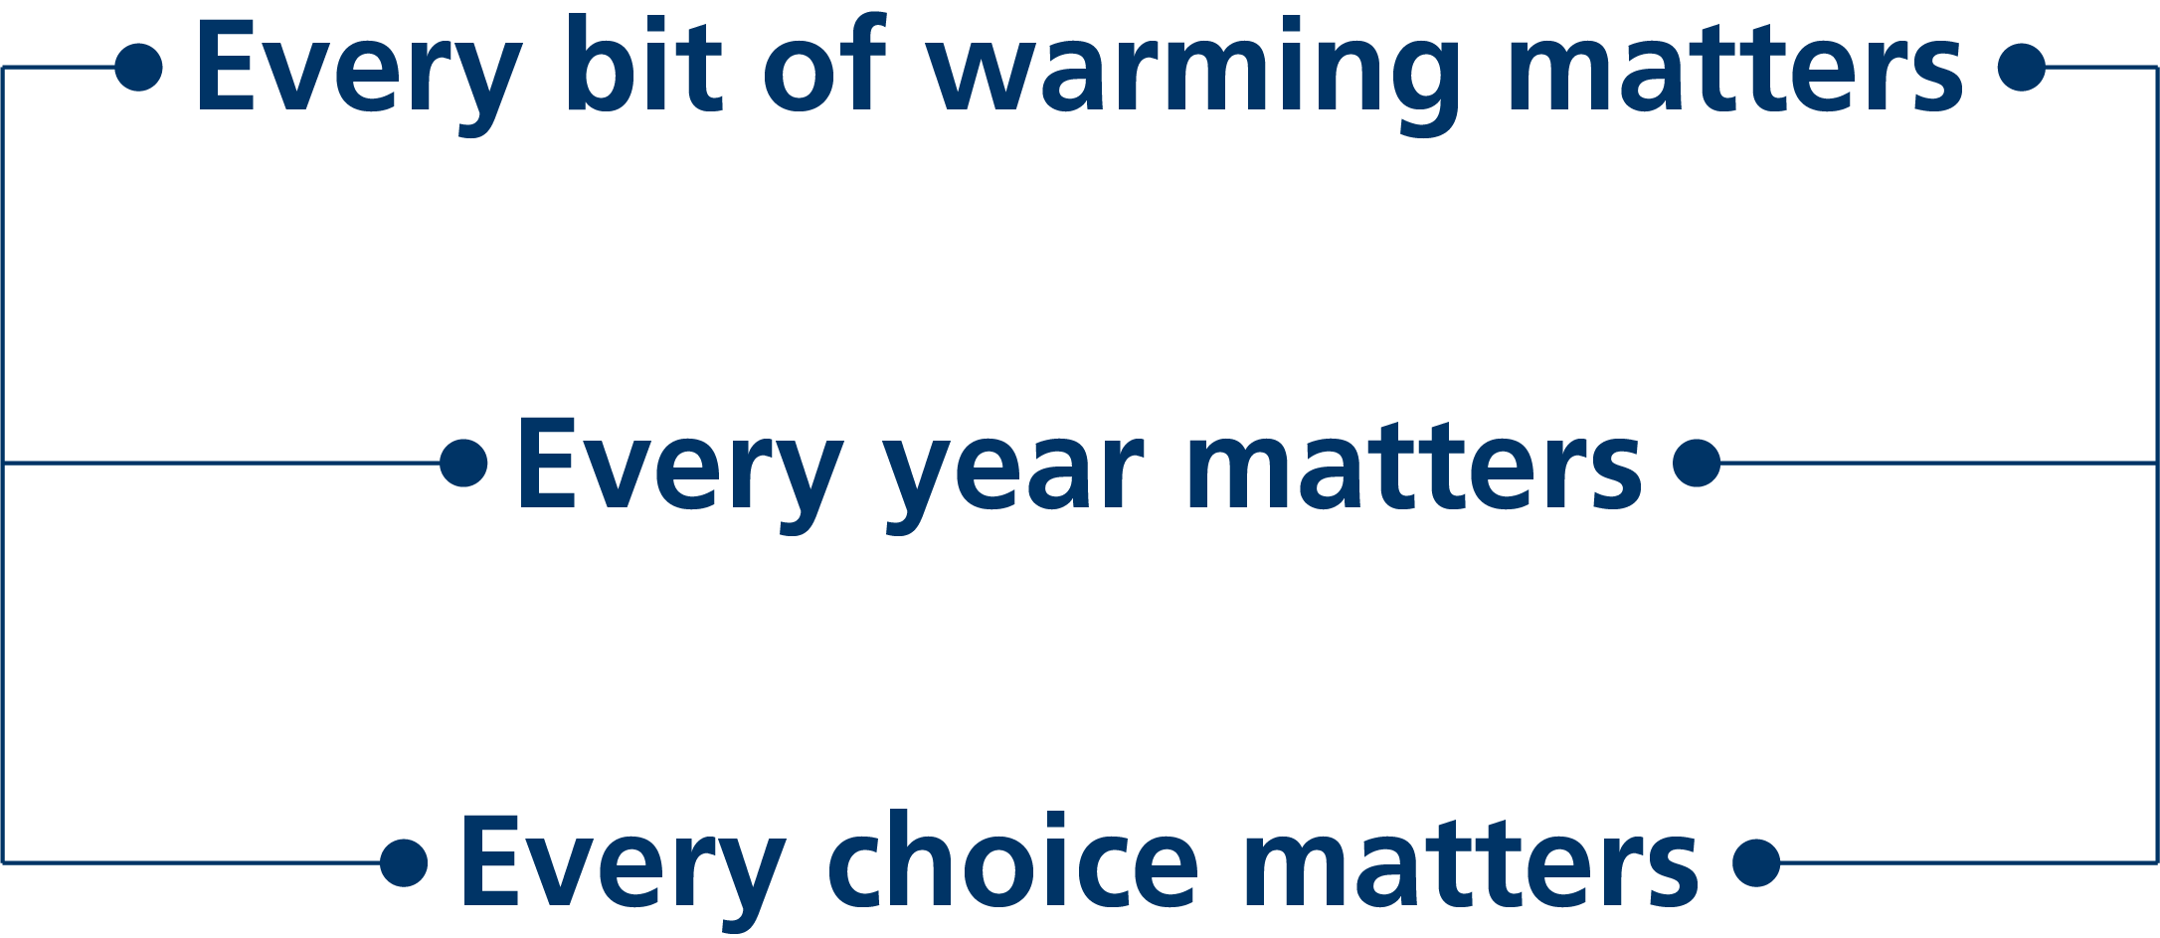

Slide 7


Our ocean and cryosphere –
They sustain us.
They are under pressure.
Their changes affect all our lives.
The time for action is now.

Slide 8
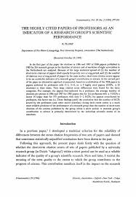





By the numbers
14,000 scientific publications assessed
Author Team
234 authors from 65 countries
28% women, 72% men
63% first-time IPCC authors
Review Process
78,000+ review comments
46 countries commented on Final
Government Distribution

Slide 9
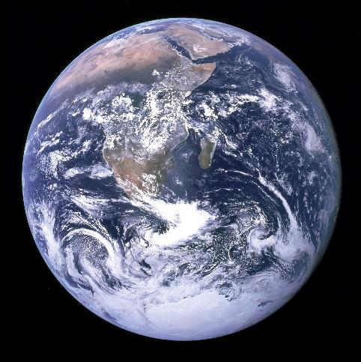
Recent changes in the climate are widespread, rapid, and intensifying, and unprecedented in thousands of years.
[Credit: NASA]

Slide 10




CO₂
concentration
Sea level
rise
Arctic sea ice
area
Glaciers
retreat
Highest
in at least
2 million years
Fastest rates
in at least
3000 years
Lowest level
in at least
1000 years
Unprecedented
in at least
2000 years

Slide 11

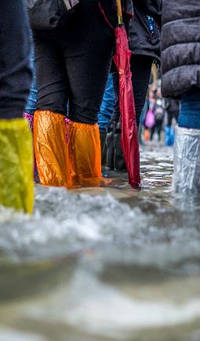
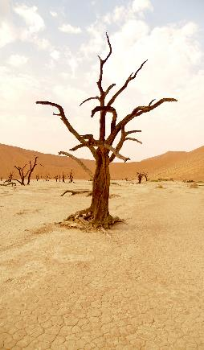
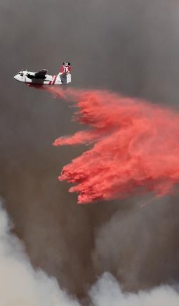
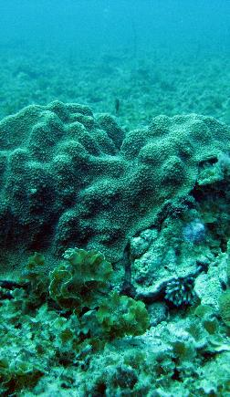
Extreme heat
More frequent
More intense
Heavy rainfall
More frequent
More intense
Drought
Increase in some regions
Fire weather
More frequent
Ocean
Warming
Acidifying
Losing oxygen
Photo Credits from left: 1. Luiz Guimaraes 2. Jonathan Ford 3. Peter Burdon 4. Ben Kuo 5. NOAA

Slide 12
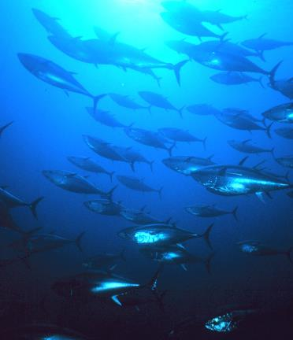
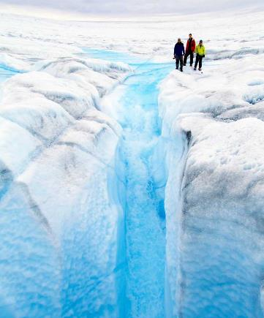
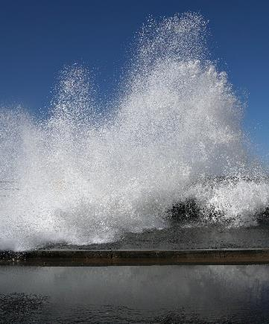
Ocean and ice sheets
Ocean temperature
Increasing
Greenland Ice Sheet
Melting
Sea level
Rising
Photo Credits from left: NOAA; Konrad Steffen; Allan Grinberg

Slide 13
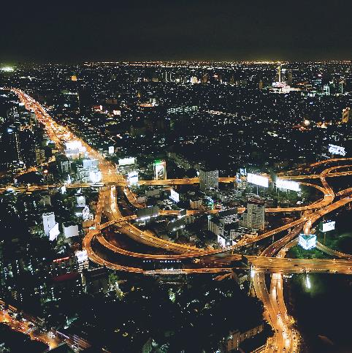
Unless there are immediate, rapid, and large-scale reductions in greenhouse gas emissions, limiting warming to 1.5°C will be beyond reach.
[Credit: Peter John Maridable]

Slide 14
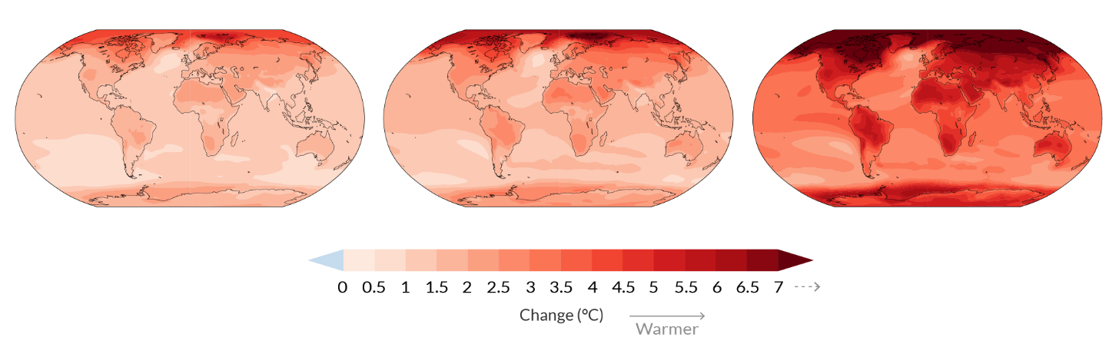
With every additional amount of global warming, changes get larger.
Simulated changes…
…at 1.5C
…at 2C
…at 4C

Slide 15
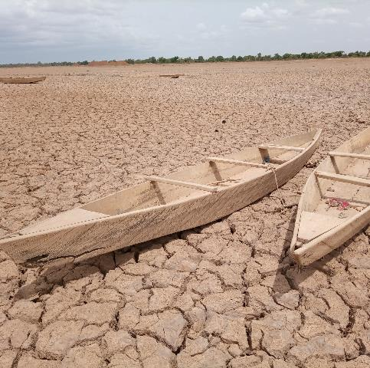
It is indisputable that human activities are causing climate change, making extreme climate events, including heat waves, heavy rainfall, and droughts, more frequent and severe.
[Credit: Yoda Adaman | Unsplash]

Slide 16
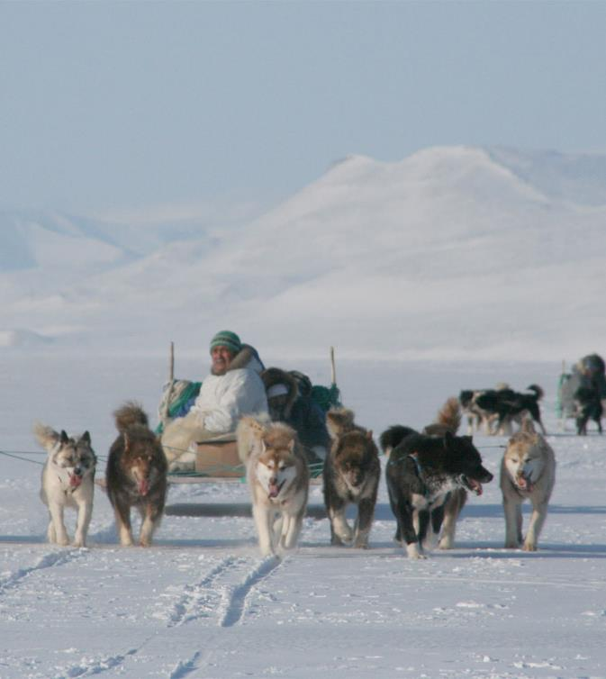
Human influence, main driver of…
…Hot extremes, which have become more frequent and more intense
…ocean warming since the 1970s, and ocean acidification.
…changes we see in the frozen areas of the planet:
  global retreat of glaciers since the 1990s
  40% decrease in Arctic sea ice since 1979
  decrease in spring snow cover since the 1950s.
Photo Credit: Andy Mahoney

Slide 17
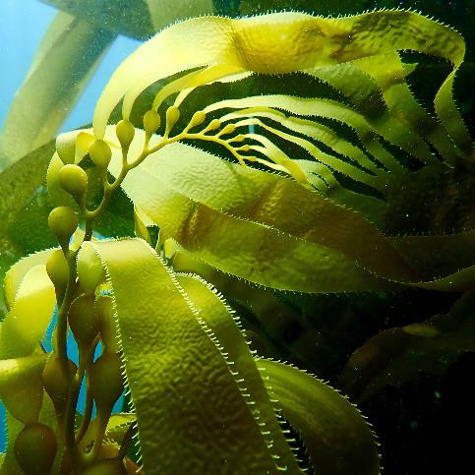
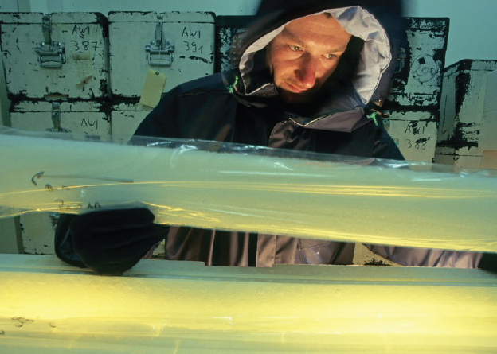
There’s no going back from some changes in the climate system…
[Credit: Jenn Caselle | UCSB]

Slide 18
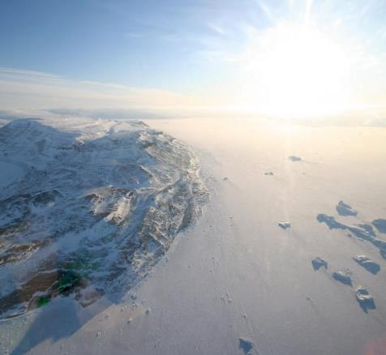
…However, some changes could be slowed and others could be stopped by limiting warming.
[Credit: Andy Mahoney | NSIDC]

Slide 19
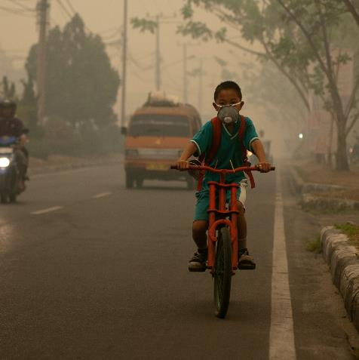
To limit global warming, strong, rapid, and sustained reductions in CO₂, methane, and other greenhouse gases are necessary.
This would not only reduce the consequences of climate change but also improve air quality.
[Credit: evgeny-nelmin.]

Slide 20
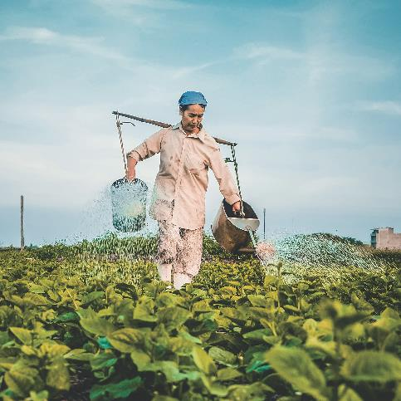
Climate change is already affecting every region on Earth, in multiple ways.
The changes we experience will increase with further warming.
[Credit: Hong Nguyen | Unsplash]

Slide 21
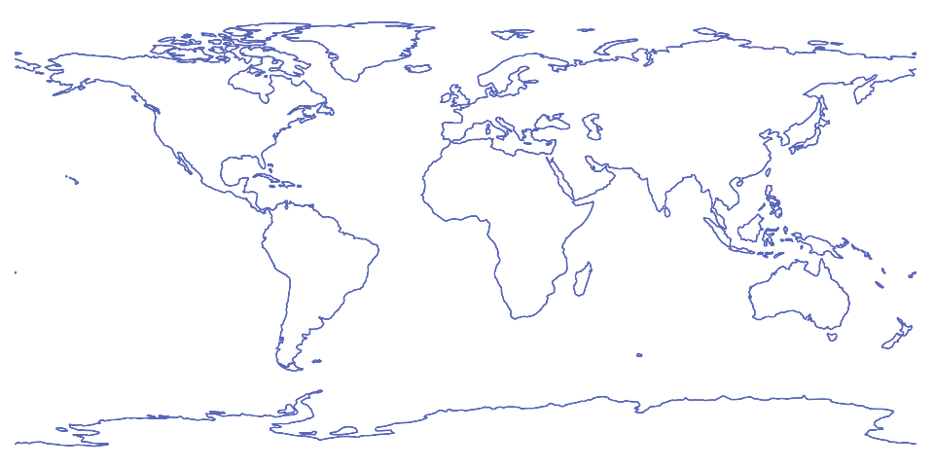
New regional information
Inform decisions related to risk management and adaptation
A third of our report is dedicated to regional climate information

Slide 22
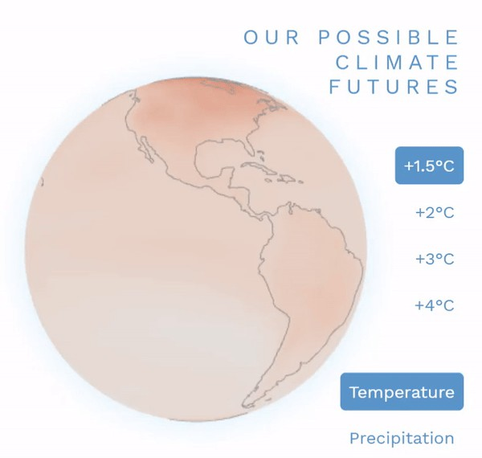
Interactive atlas
https://interactive-atlas.ipcc.ch/
#IPCCData #IPCCAtlas

